Slide 1
Food and Agriculture Organization

Slide 2
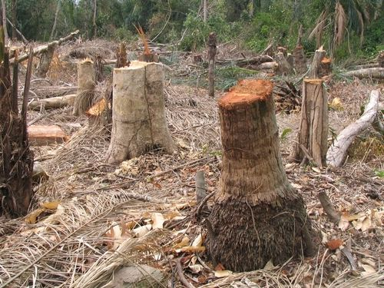
Deforestation - One of the biggest ecological problems

Slide 3
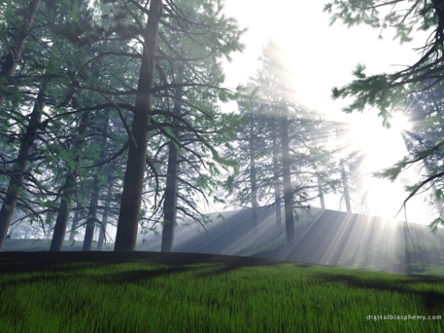
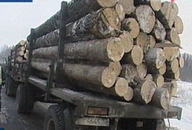
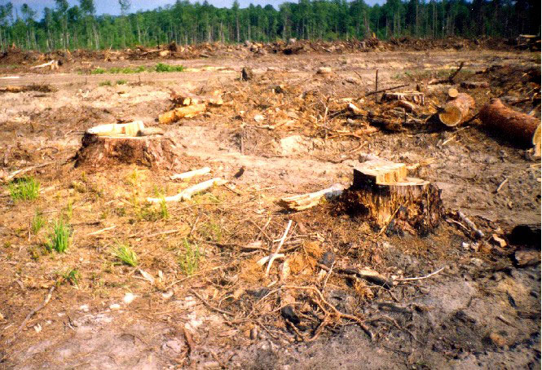
The problem of forests felling
Our forests are disappearing because they are
cut down or burnt. If this trend continues, one
day we won’t have enough oxygen to breathe,
we won’t see beautiful green forests at all.

Slide 4
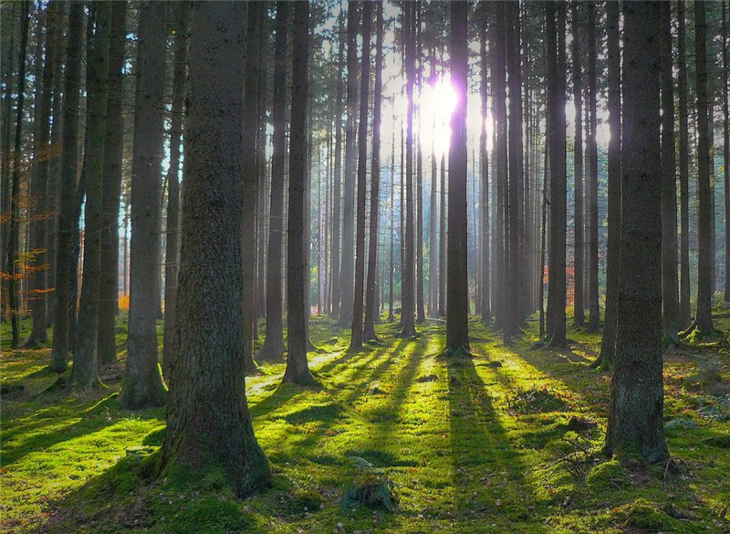
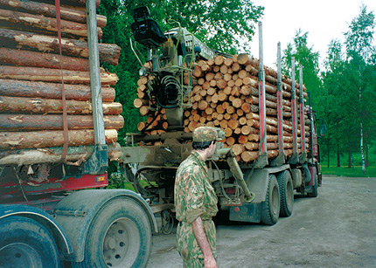
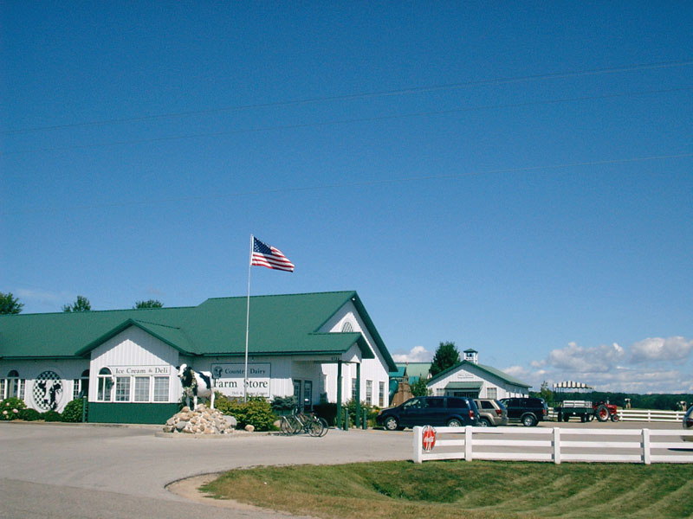
Deforestation has become a big problem around the globe because many forests are being cleared to make room for new farms, and less trees mean more impact on global warming and climate change.

Slide 5
?
?
?
?
?
?
?
?
?
?
?
?
?

Slide 6
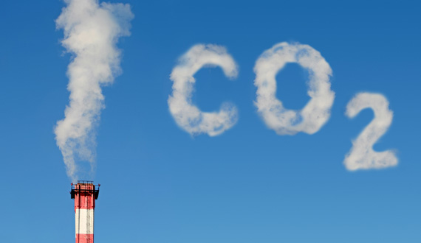
20%

Slide 7
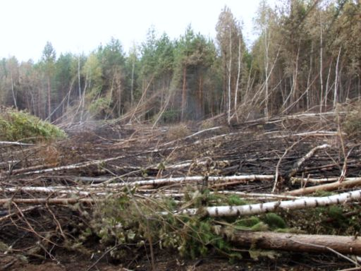
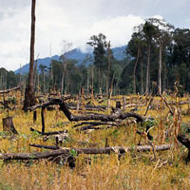
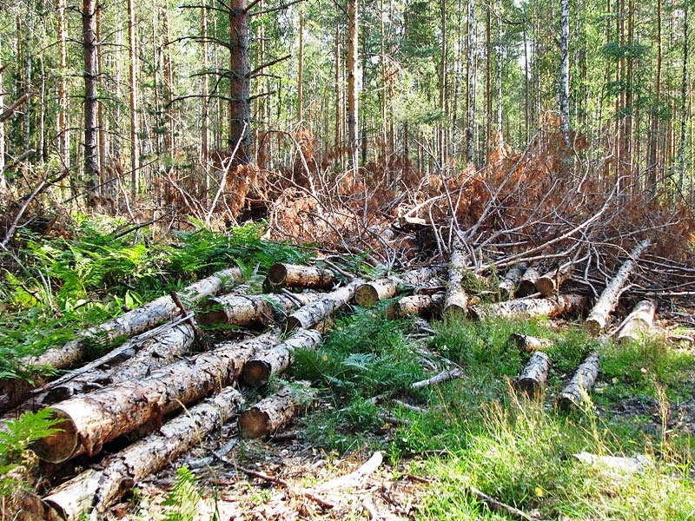
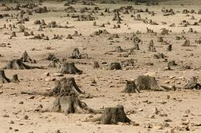
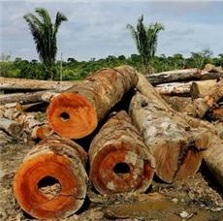
S
т
o
p

Slide 8
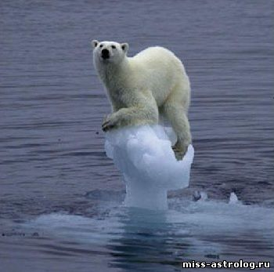
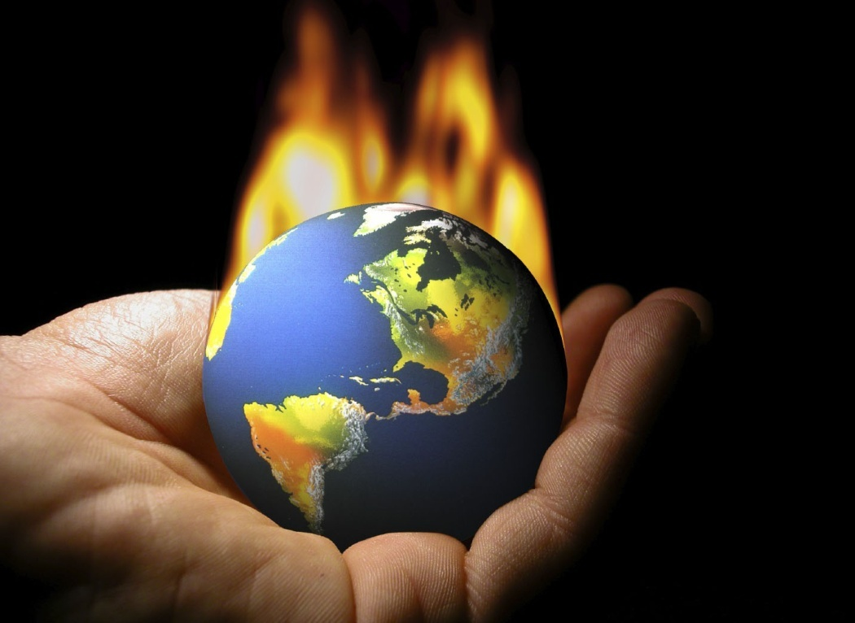
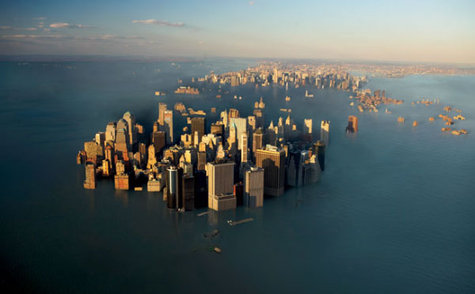
Forests protect the planet from global warming

Slide 9
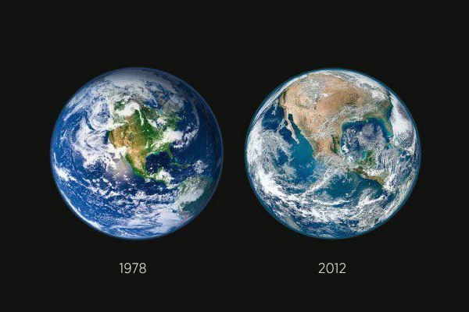
Pictures of NASA. Deforestation in America
The difference in 34 years.

Slide 10
Don't forget that our planet is our home! We must save the Earth!

Slide 11
Thank you for
your attention!

