Slide 1
Air Pollution

Slide 2
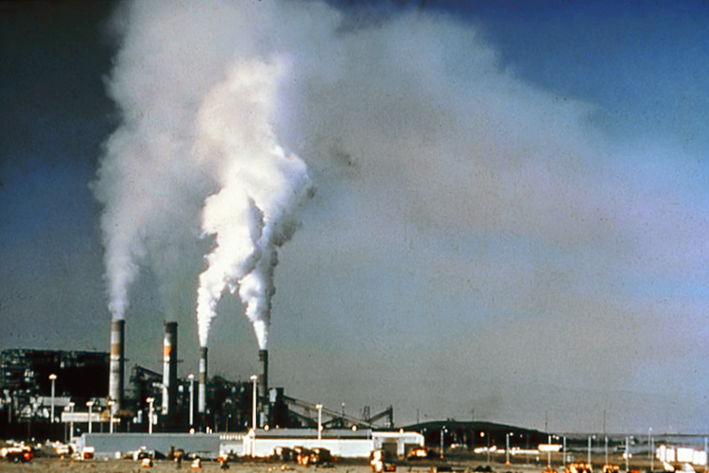
Air pollution is the release of chemicals, particular matter, or biological materials that cause harm or discomfort to humans or other living organisms, or cause damage to the natural environment or built environment, into the atmosphere.

Slide 3
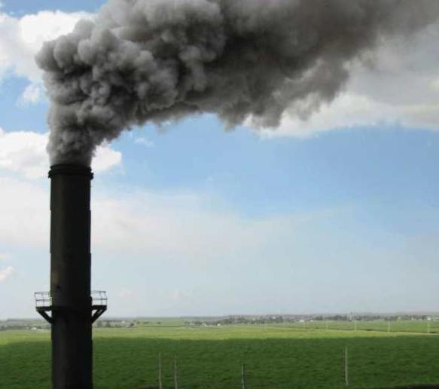

Slide 4
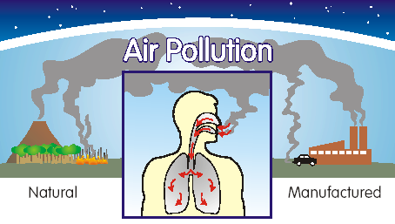

Slide 5
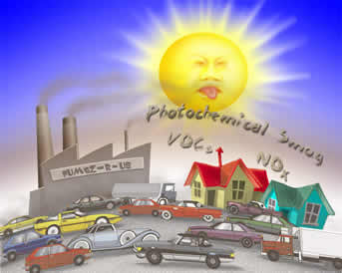
Smog is created by burning coal and heavy oil that contain sulphur impurities at power plants, industrial plants, etc... The smog consists mostly of a mixture of sulphur dioxide and fog.

Slide 6
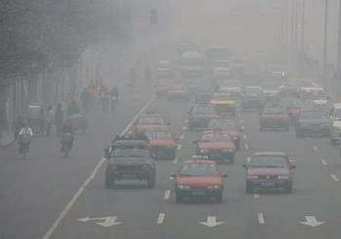
Hong Kong air pollution

Slide 7
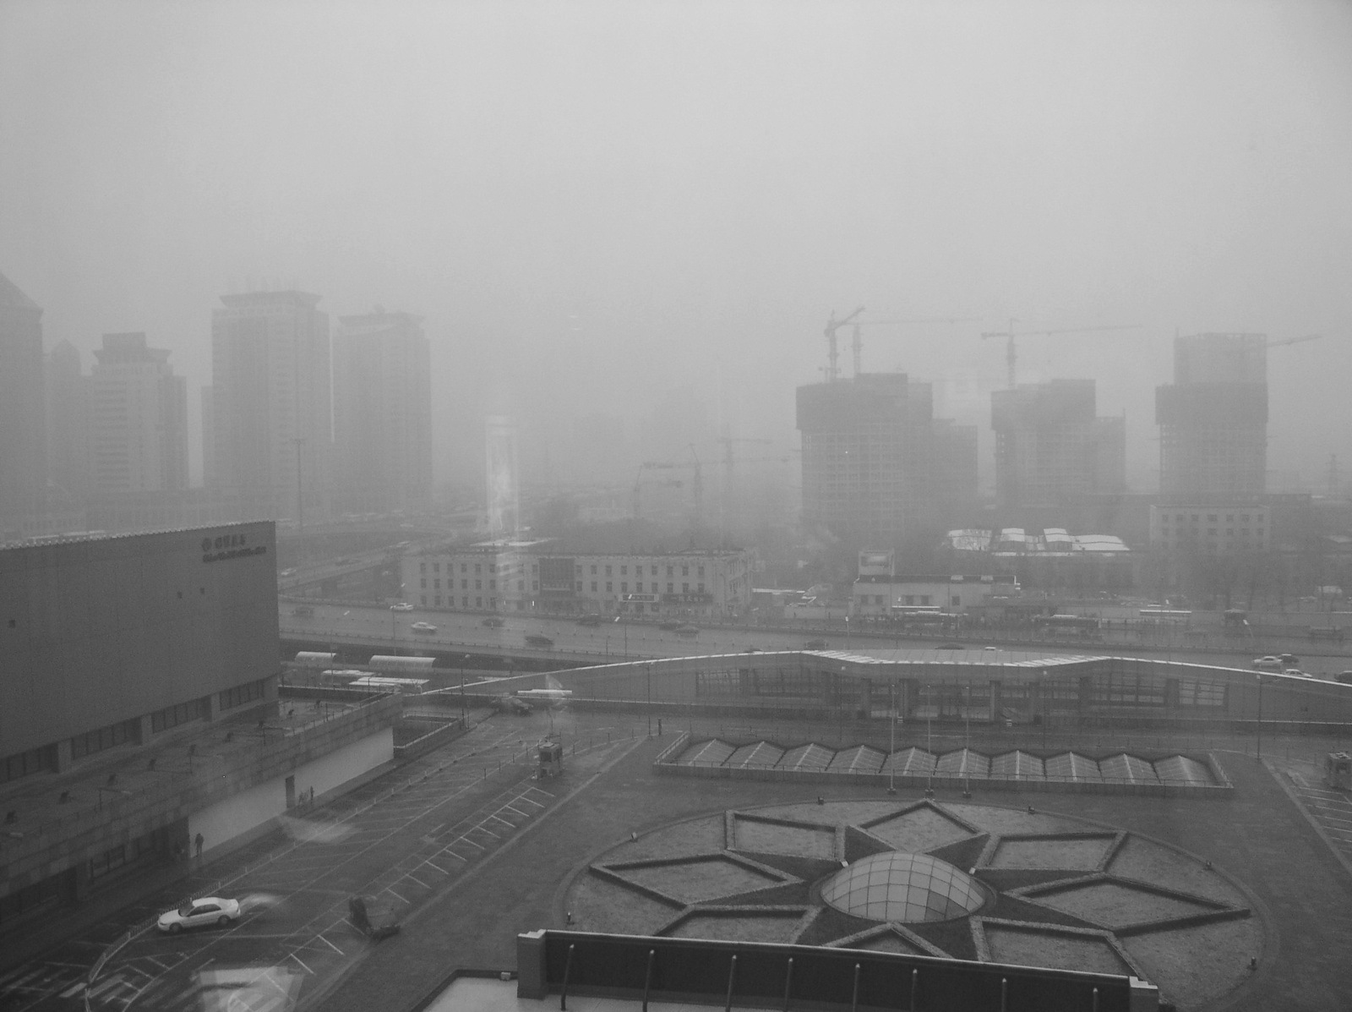

Slide 8
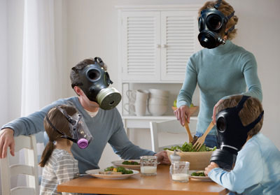
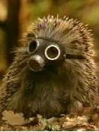
Save yourself

Slide 9
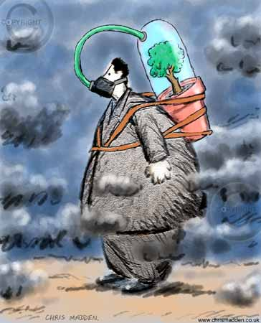

Slide 10
Film about air pollution

Slide 11
The End

