Slide 1
ADAPTIVE ALGORITHMS IN VIBRATION DIAGNOSIS
Belarusian State University of Informatics and Radioelectronics
The Republic of Belarus, Minsk 2013
A.V. Tsurko
Liahushevich S.I. − Associate Professor

Slide 2
Plan
Rolling bearing structure
Test rig equipment
Vibration noise
Vibration diagnosis process
Adaptive algorithm concept
Machine learning systems

Slide 3
Rolling bearing structure
Outer Ring
Ball
Cage
Ball Race
Inner Ring

Slide 4
Test Rig Equipment
Rolling Bearing
Induction motor
Accelerometer
Heavy metal base o table
Rubber spacer
Computer

Slide 5
Vibration noise
Normal bearing: waveform and the spectrum
Defective outer race: waveform and the spectrum

Slide 6
Vibration diagnosis process
The process includes five sequential phases:
Theoretical model development
Empirical data obtaining
Diagnostic feature extraction
Fault state classification
Fault progress prediction and decisions

Slide 7
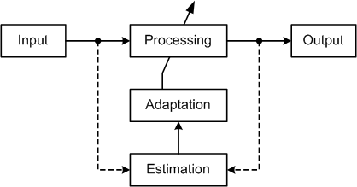
Adaptive algorithm concept
Adaptation means (re)tuning of system parameters for better performance
In modern vibration analysis adaptation algorithms are mainly used for classification at the fourth diagnosis phase.

Slide 8
Machine learning systems
Uncertainty of input data require using of adaptive data processing
Best effectiveness in classification is provided by machine learning systems
Such systems adapt to input data in process of training (learning) by selected data set under control of human-supervisor
Most common and effective machine learning techniques are ANN (BP-based MLP) and SVM

Slide 9
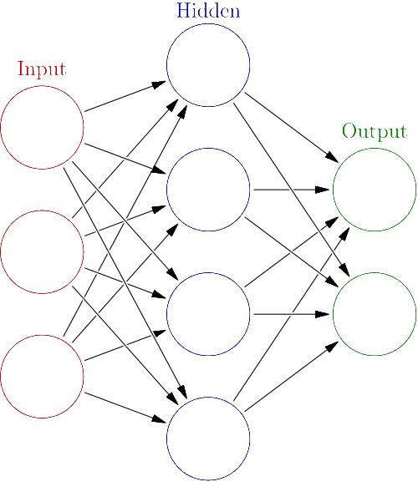
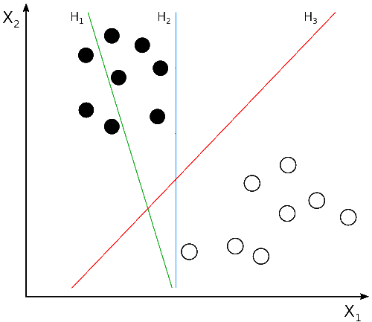
Artificial Neural Network (ANN) and Support Vector Machine (SVM)
SVM places a Hyperplane (H):
H1 does not separate the classes. H2 does, but only with a small margin. H3 separates them with the maximum margin.
ANN is an interconnected group of nodes, akin to the vast network of neurons in a brain.

Slide 10
Thanks for attention ask your questions

