Slide 1
3D printing (Additive Manufacturing)
Author: malashkov valentin

Slide 2
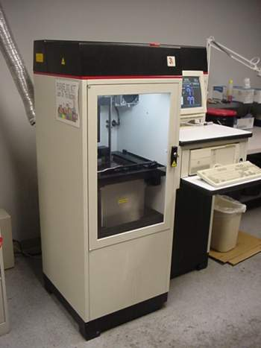
Introduction
Charles “Chuck” Hull invented the first form of 3D printing – Stereolithography
The first Stereolithographic Apparatus (SLA) is made by 3D Systems

Slide 3
3D printers sold per year. Sales of consumer-grade machines (less than
$5,000) begins in 2007 and outpaces sales of industrial-grade machines
in 2011.

Slide 4
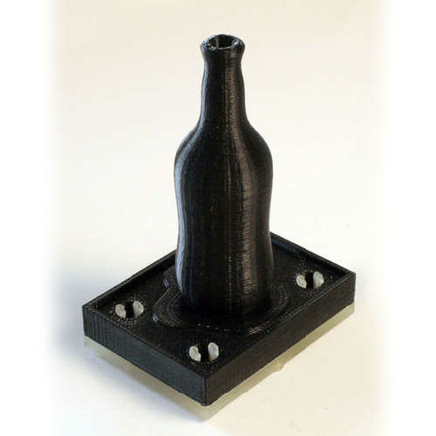
General principle
Preparing a design file
Calculating a mechanical path
Printing

Slide 5
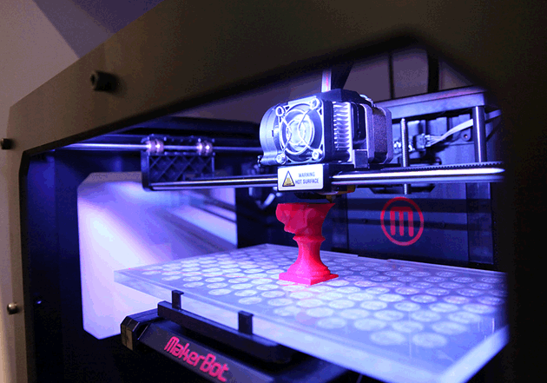
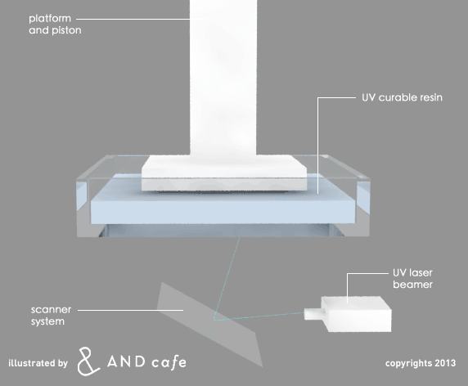
Differences between 3D printers
3D printers
Selective deposition printers
Selective binding printers

Slide 6
Selective Deposition Printers
Selective deposition printers
Fused Deposition Modeling
PolyJet
Laser Engineered Net Shaping

Slide 7
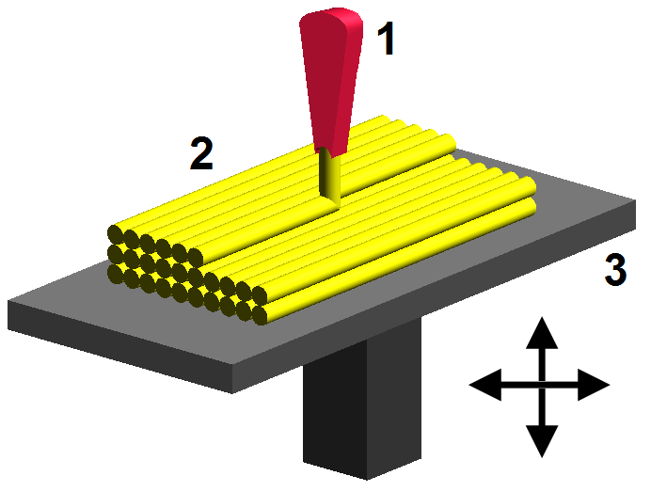
Fused Deposition Modeling (FDM)
Material: soft plastic, living cells or even raw cookie dough
Pluses: ideal for home and office use
Minuses: use only soft materials

Slide 8
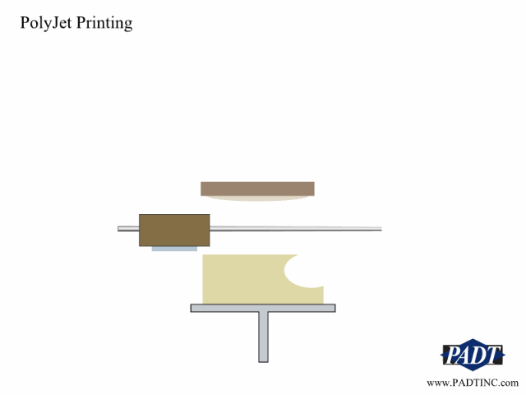
Polyjet (Material Jetting)
Material: photopolymer
Pluses: fast and precise
Minuses: photopolymer is expensive and fragile

Slide 9
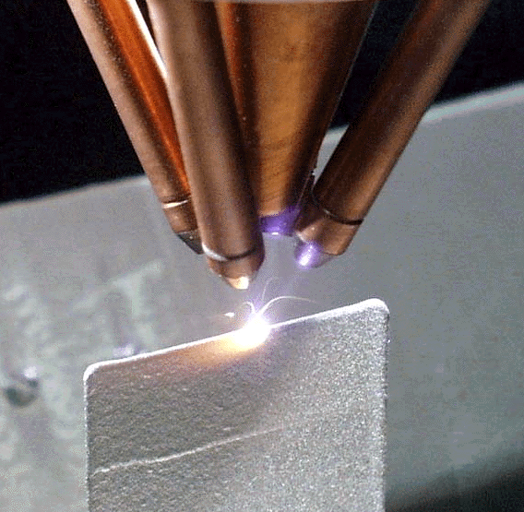
Laser Engineered Net Shaping (LENS)
Material: usually metal materials
Pluses: can use hard materials
Minuses: not for home use

Slide 10
Selective Binding Printers
Selective Deposition Printers
Stereolithography
Selective Laser Sintering

Slide 11
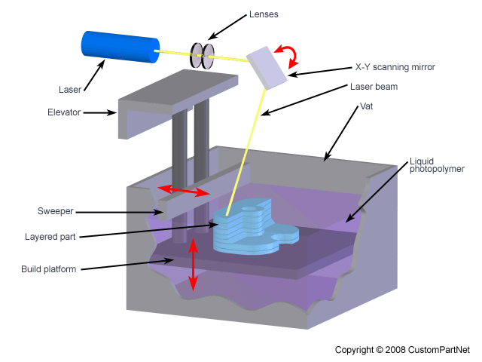
Stereolithography (SL)
Material: photopolymer
Pluses: fast and precise
Minuses: photopolymer is expensive and fragile, fumes from photopolymer can be dangerous

Slide 12
LASER SINTERING
Material: usually metal materials
Pluses: can use hard materials
Minuses: not for home use

Slide 13
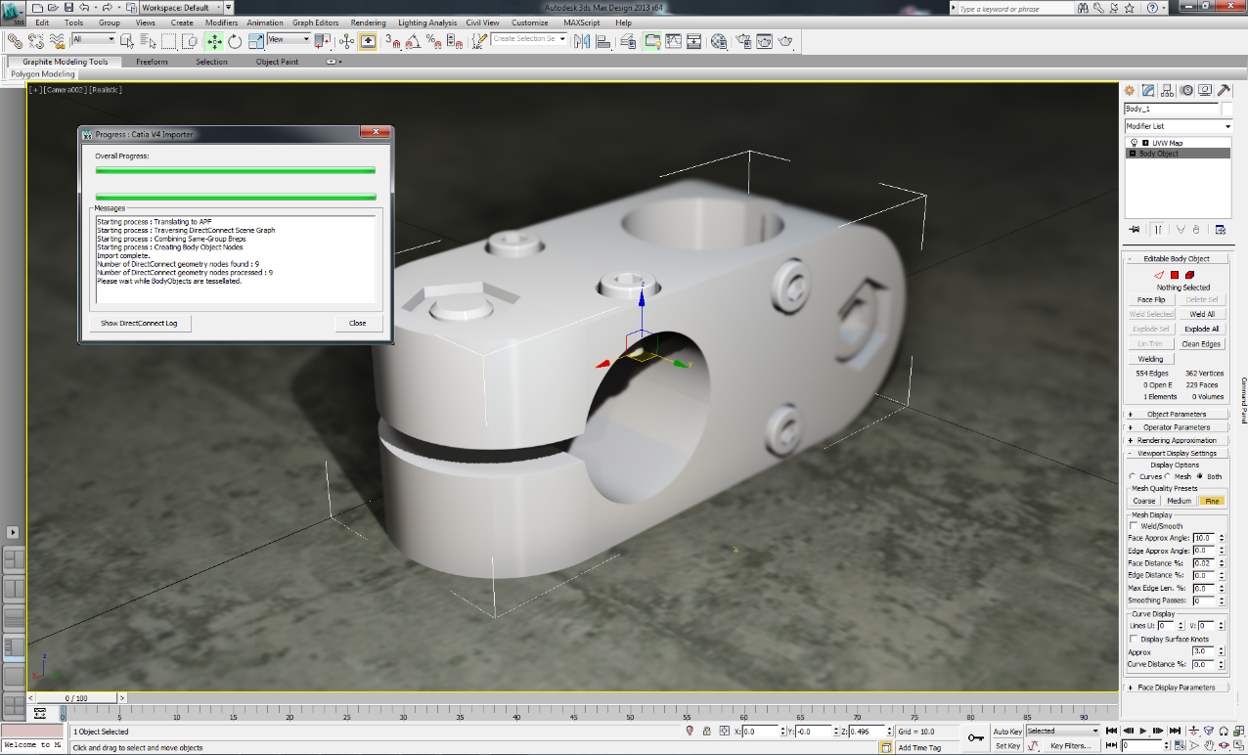
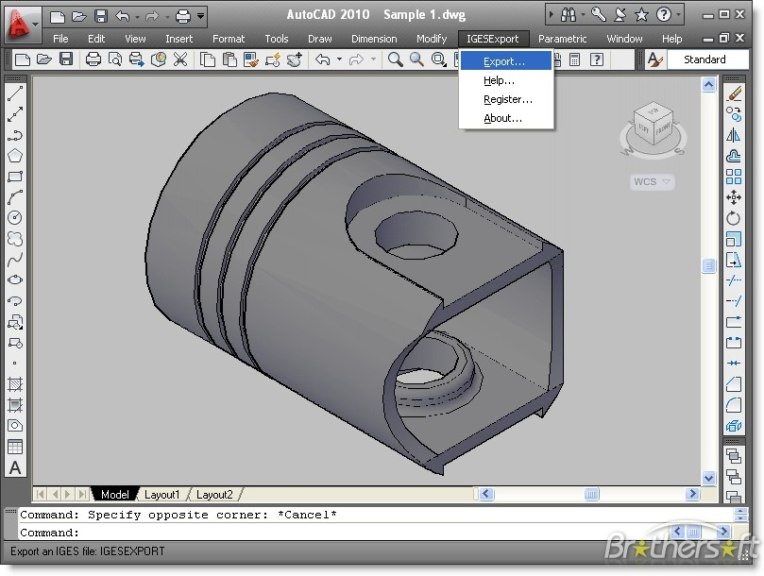
Design file

Slide 14
A tool represented in a STL file

Slide 15
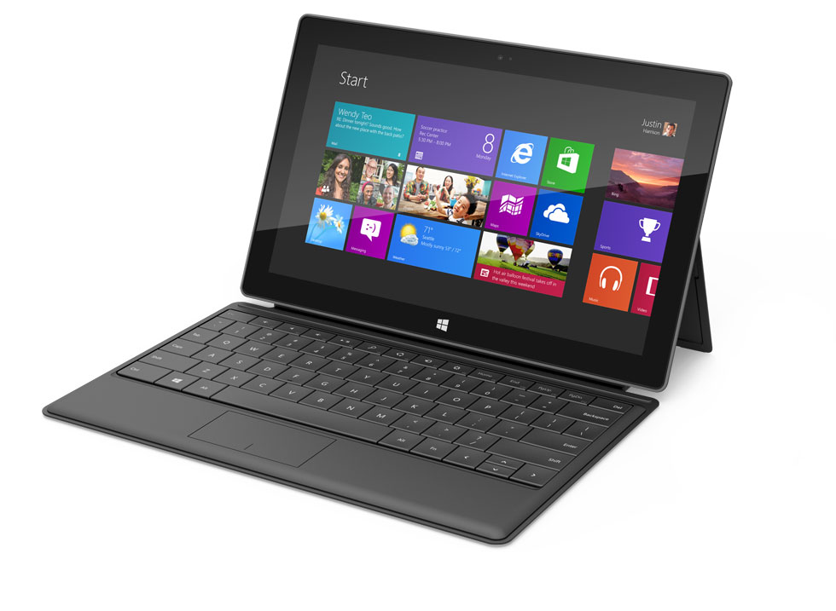
Rapid Prototyping

Slide 16
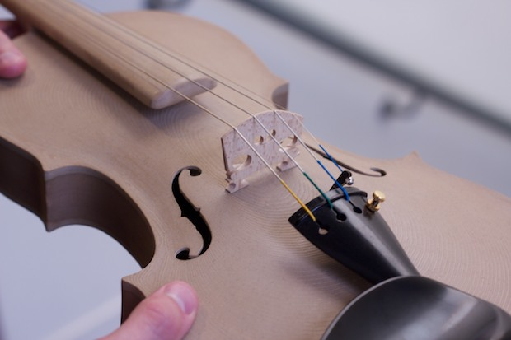
3D printed musical instruments

Slide 17
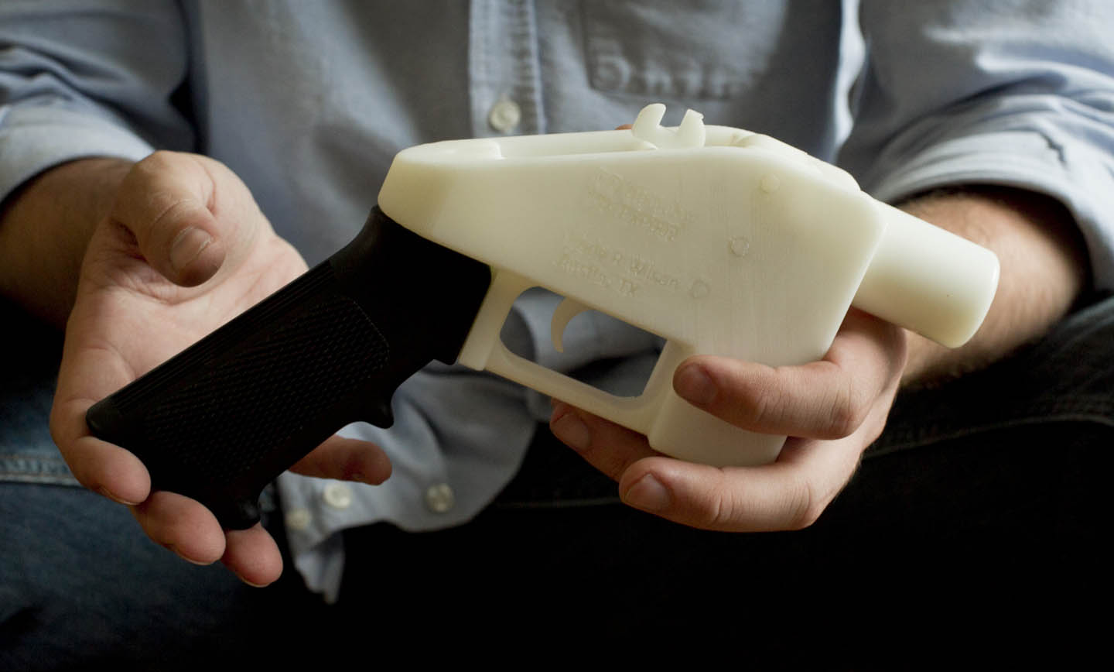
3D printed guns

Slide 18
Bioprinting

Slide 19
Future of 3D printing
Control over the shape
Control over the composition
Control over the bahavior
Analog to digital
Analog vs digital representation

Slide 20
The End.

