Slide 1
Public key cryptosystems and their application in digital signature algorithms
Prepared by Glushachenko N.S.

Slide 2
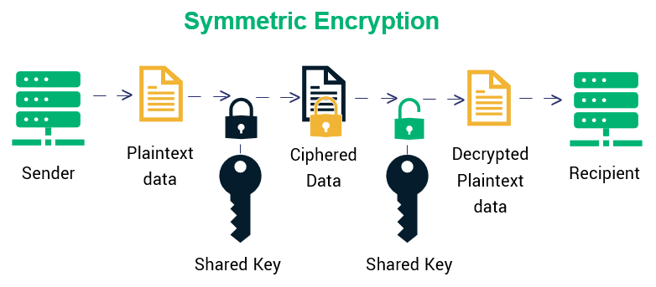
Symmetric encryption algorithms use a single secret key to encrypt and decrypt messages

Slide 3
Disadvantages:
Key distribution: In symmetric cryptosystems, both the sender and receiver need to have the same key to encrypt and decrypt the message. However, securely sharing the key between the two parties can be difficult, especially if they are geographically distant or have different security policies.
Key management: Symmetric keys are typically used for a limited time (e.g., for a single session), and then discarded or replaced with a new key. Managing a large number of keys can be challenging, especially if they are used across different systems or applications.
Lack of non-repudiation: Symmetric encryption only provides confidentiality, but not authentication or non-repudiation. This means that the sender of a message cannot be verified, and the receiver cannot prove to a third party that the message was indeed sent by the claimed sender.

Slide 4
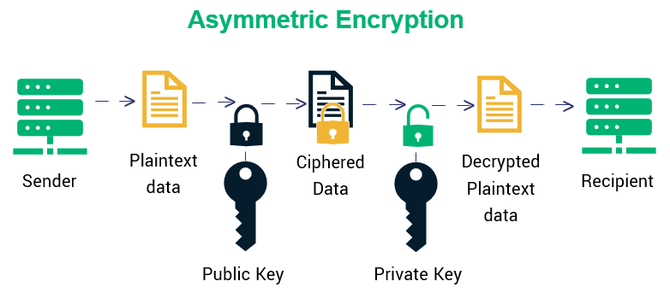
Asymmetric encryption uses a pair of keys: a public key and a private key.
public key known to all users. It allows to encrypt a message or verify its author;
private key, known only to the recipient. It is used to decrypt messages or create signatures.

Slide 5
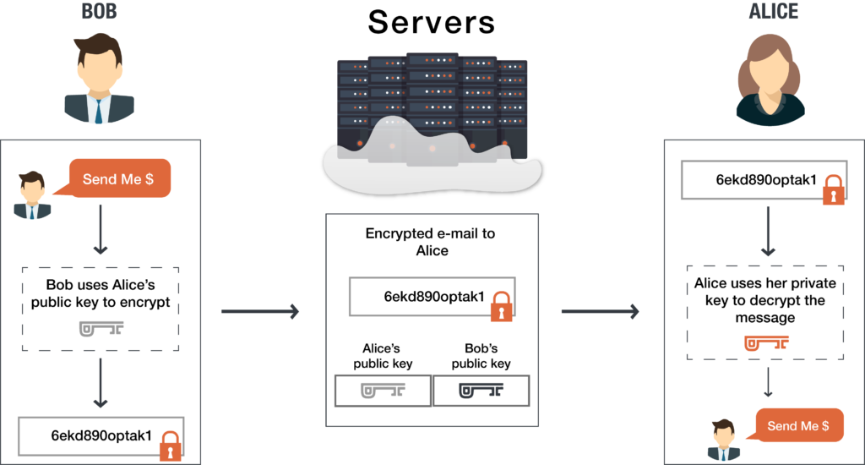
Communications with public key encryption

Slide 6
Diffie and Hellman algorithm
Diffie–Hellman key exchange is a mathematical method of securely exchanging cryptographic keys over a public channel and was one of the first public-key protocols. Named after Whitfield Diffie and Martin Hellman. Published in 1976 by Diffie and Hellman.

Slide 7
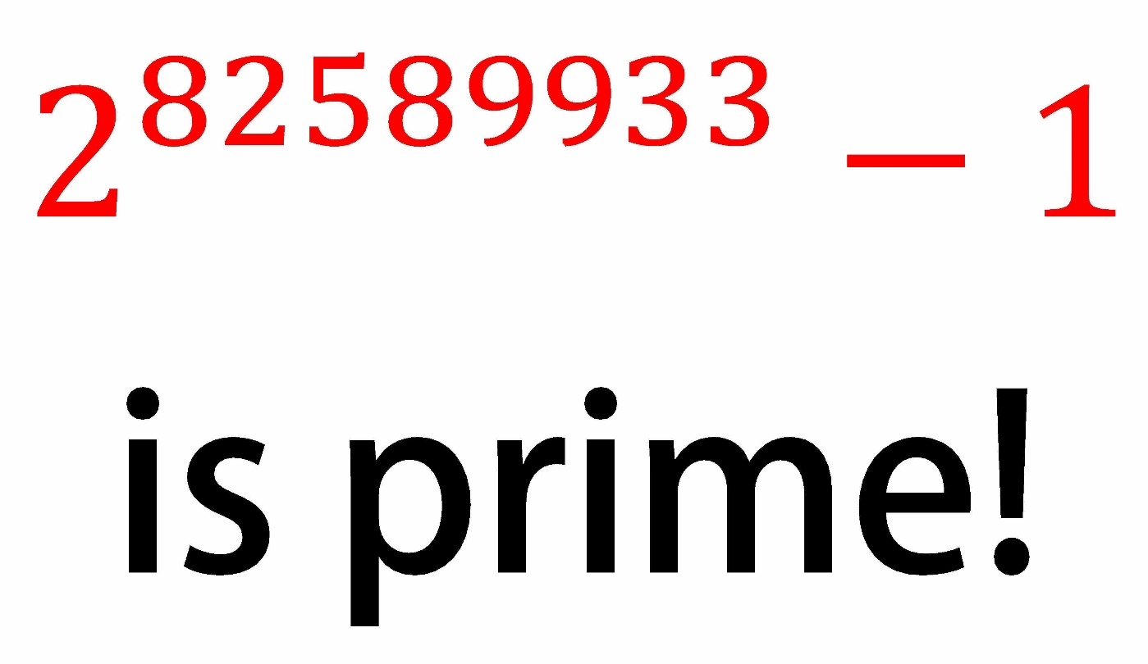
22 million digits

Slide 8
Diffie and Hellman key distribution
Step 1:
Select a large prime number q
Select number a, which will be a primitive element of the finite field GF(q) with q – 1 unique elements
*q and a can be intercepted, but this will not affect the efficiency of the encryption.

Slide 9
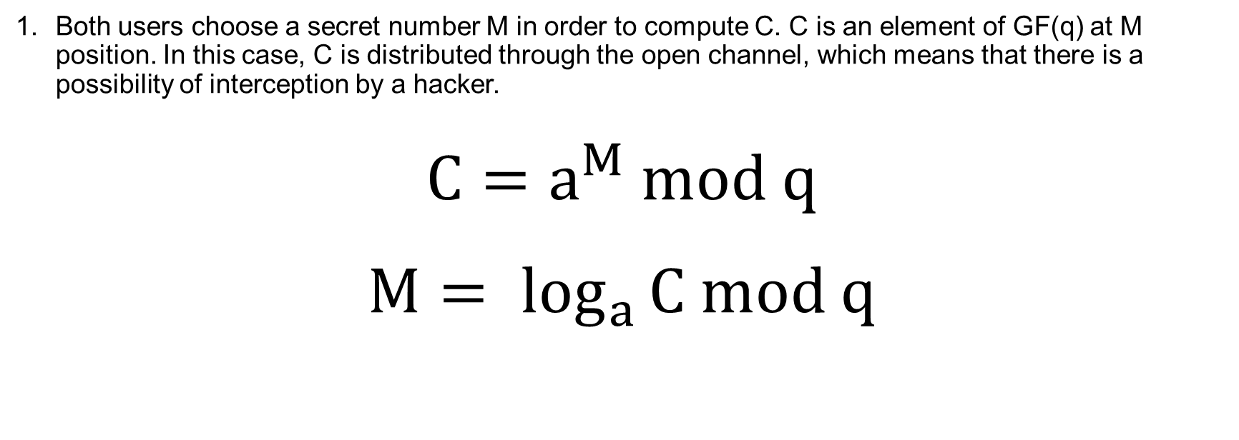
Diffie and Hellman key distribution
Step 2:
Both users choose a secret number M in order to compute C. C is an element of GF(q) at M position. In this case, C is distributed through the open channel, which means that there is a possibility of interception by a hacker.
$$C=a^{M} mod q$$
$$M= \log_{a}{C mod q}$$

Slide 10
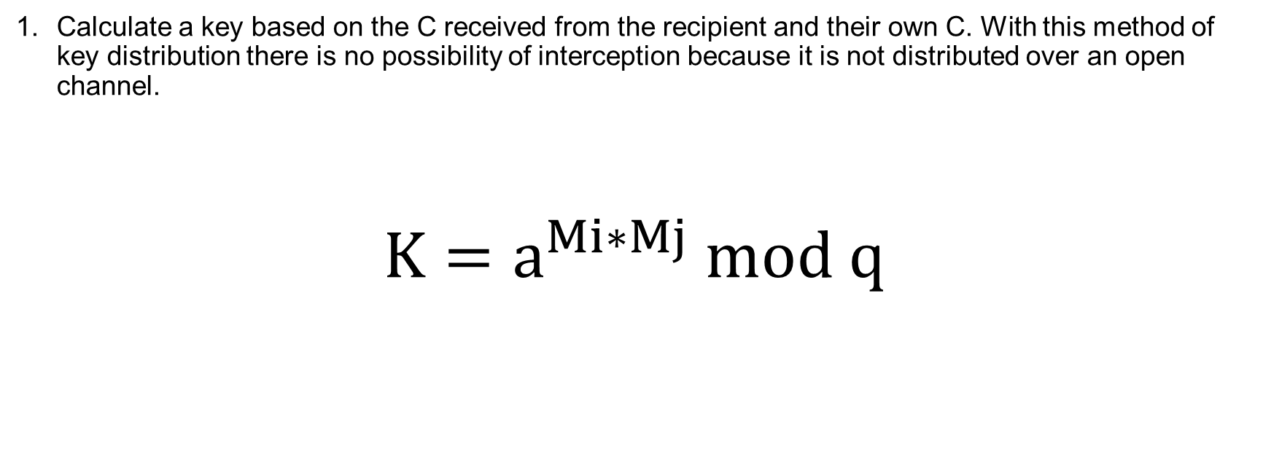
Diffie and Hellman key distribution
Step 3:
Calculate a key based on the C received from the recipient and their own C. With this method of key distribution there is no possibility of interception because it is not distributed over an open channel.
$$K=a^{Mi∗Mj} mod q$$

Slide 11
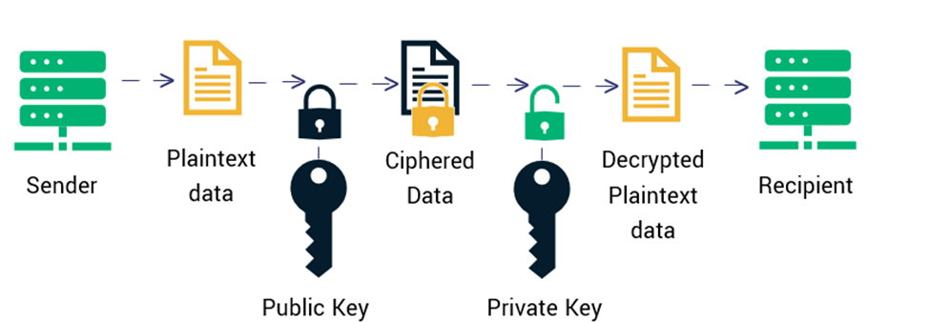
Digital signatures

Slide 12
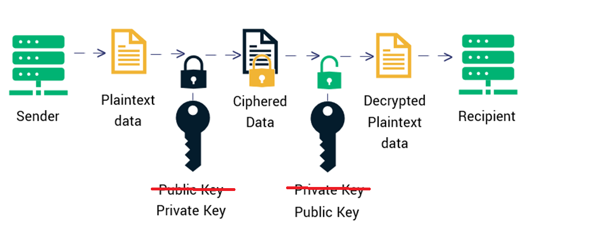
Digital signatures
There are three features that could be stated as the most important properties of such algorithms:
anyone can verify the authenticity of the signature
the possibility of forgery is excluded
the author cannot refuse the signature.

Slide 13
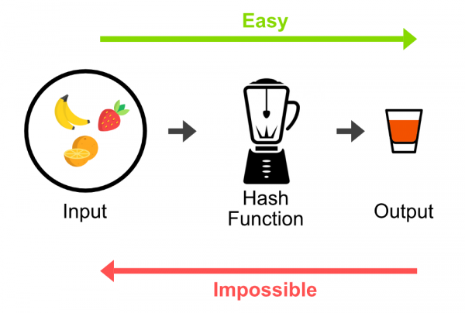
One-way function
A one-way function is a function for which obtaining an argument, knowing its value, is not possible in a reasonable amount of time with the current level of computing power. This means that it is easy to turn raw data into encrypted data, but impossible to do the opposite in a reasonable time.
In digital signatures hash function is one-way function.

Slide 14
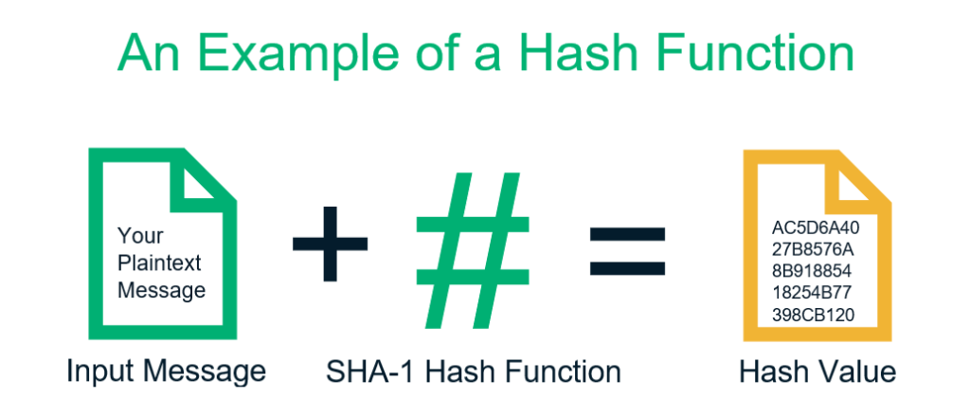
Hash function
Hash functions are expected to meet the following requirements:
the result of hash function must be significantly different for small changes in the original message,
hash function must match each unique message with a unique hash,
hash repetitions must be excluded.

Slide 15
Digital signatures
Sender:
1. Calculate the hash of the original message using hash function.
2. Encrypt the hash using a secret key. The result is a digital signature.
3. Form a new message consisting of an original message and a digital signature added to it.
Recipient:
1. Calculate the message hash using a hash function.
2. Using the public key, decrypt the digital signature and obtain the original hash.
3. Compare calculated value with hash value extracted from digital signature. If hashes match, the signature is considered authentic.
It should be noted, that a digital signature can be realized based on symmetric algorithms as well, but such algorithms are applicable only for single-use signatures. It is connected with the fact that during verification of a signature the user receives half of encryption keys and later can forge the signature. This leads to the necessity to generate unique keys for each signature.

Slide 16
The importance of public key cryptosystems
Message encryption
  E-mails
  Banking transactions
  Communications
Digital signatures
Digital cash

