Slide 1

01
E-COMMERCE IN THE PANDEMIC-ERA: ANALYSIS OF CONSUMER AND PRODUCER BEHAVIOUR CHANGES, PERSPECTIVES
Unlocking the post-COVID marketplace

Slide 2


02
CONTENT OF THE ARTICLE:
The impact of the COVID-19 pandemic on the global economy
Prediction of the trend towards e-commerce
Importance of mobile commerce and personalized shopping experiences
Unlocking the post-COVID marketplace

Slide 3
03
CONSEQUENCES
STAGE 3
STAGE 1
STAGE 2
Changes in producer behaviour
Sudden increase in demand for e-commerce
Changes in consumer behaviour
Unlocking the post-COVID marketplace

Slide 4
04
CHANGES IN PRODUCER BEHAVIOUR
GROUP 4
GROUP 3
Need in investing in technologies
Addressing challenges in e-commerce
GROUP 1
GROUP 2
Digital transformation
Agility in retail industry
Social commerce
Virtual try-on
Augmented reality
Pivot the strategies
Shift focus to online

Slide 5

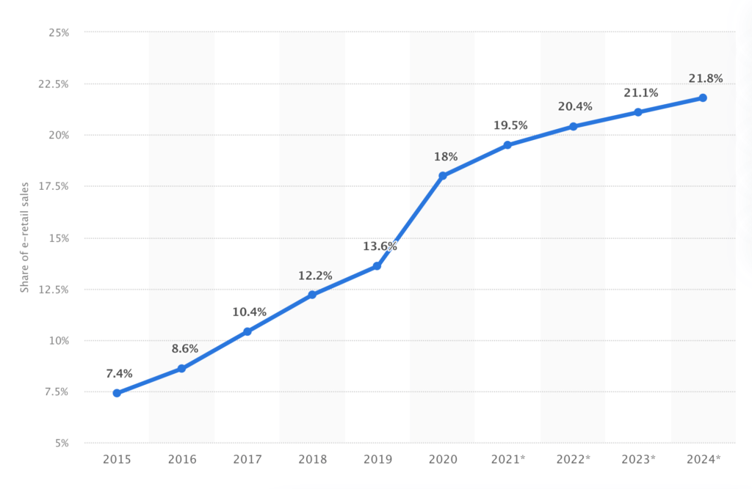
05

Slide 6
06
CHANGES IN CONSUMER BEHAVIOUR
GROUP 1
GROUP 3
GROUP 4
Preference for online shopping
Types of products consumers buy
GROUP 2
Safety concerns
Increase in online orders
Convenience
Rise in demand for delivery products
Price sensitivity
Contactless paymentt

Slide 7
07
Perspectives of E-commerce
Security concerns
Delivery of products
Mobile commerce
Social commerce
Personalized shopping experiences

Slide 8

Unlocking the post-COVID marketplace
RESULTS
SIGNIFICANT CHANGES IN CONSUMER AND PRODUCER BEHAVIOUR
GROWTH OF E-COMMERCE
NEW CHALLENGES FOR BUSINESS
ADOPTION OF NEW TECHNOLOGIES

