Slide 1
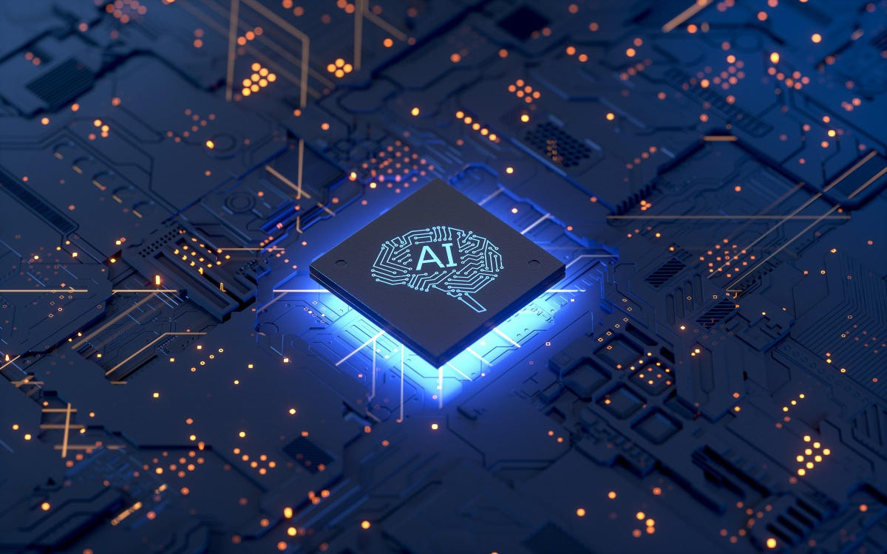
Artificial Intelligence in Our Daily Life
Presented by:
Lepushenko D.S.
Group 222402
Supervised by:
Maksimchuk R.T.
Senior Lecturer

Slide 2
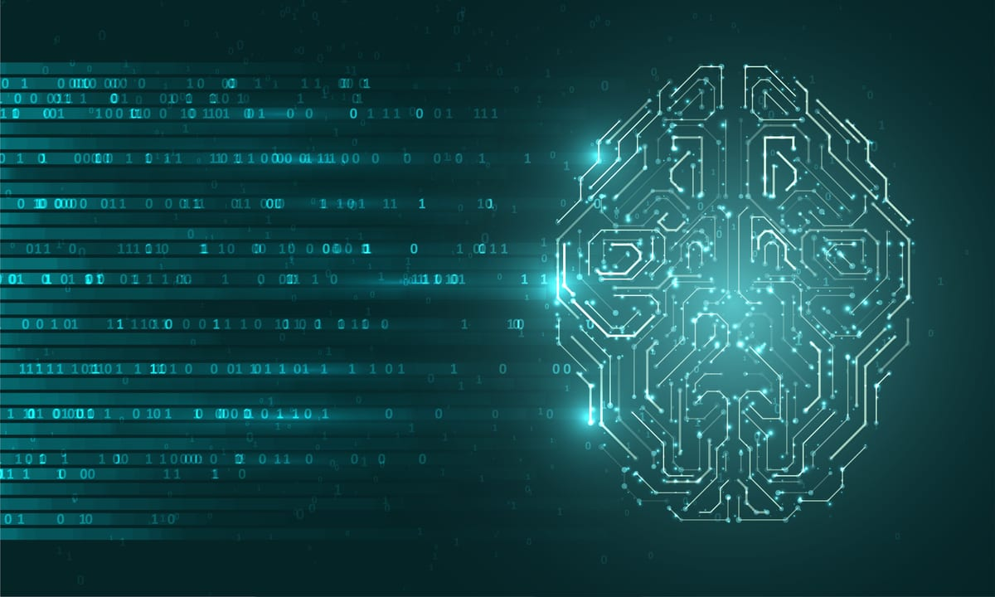
What does the term “Artificial Intelligence” mean?
Artificial Intelligence is the simulation of human intelligence processes by digital computers or computer-controlled robots

Slide 3
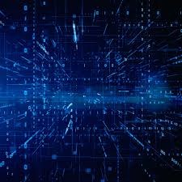
Spheres of our life influenced by AI:
Business and Marketing
Healthcare
Entertainment
Education
Transportation

Slide 4
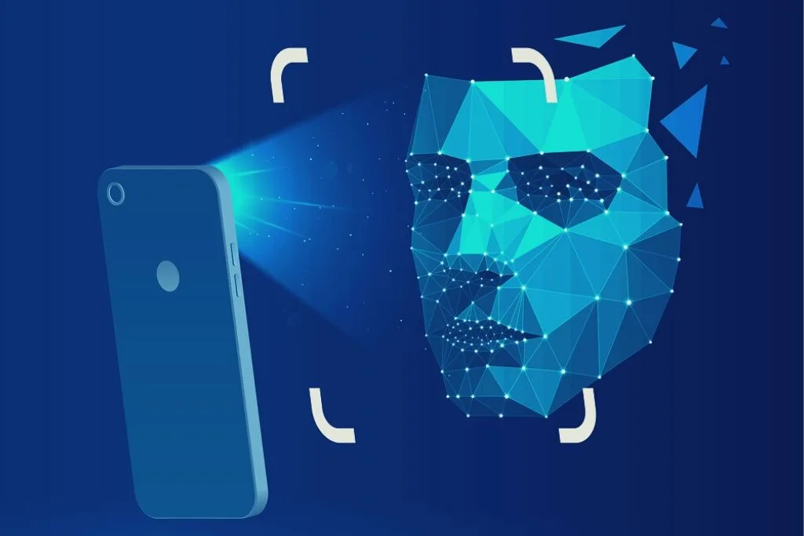
Face Recognition

Slide 5

Personalised Advertisements and Feeds

Slide 6
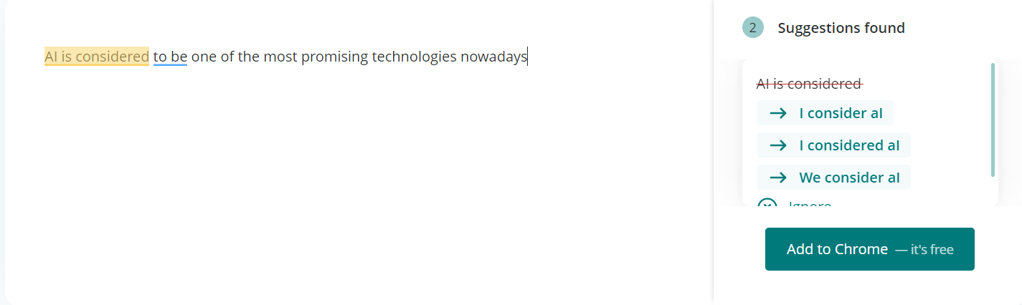
Grammar and Spell Check

Slide 7


Slide 8
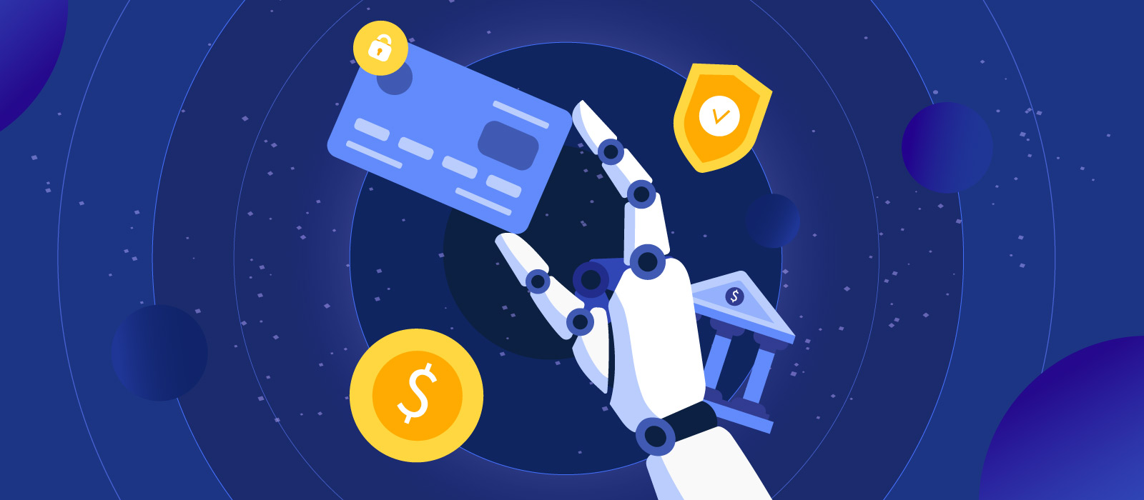
Transaction Control

Slide 9
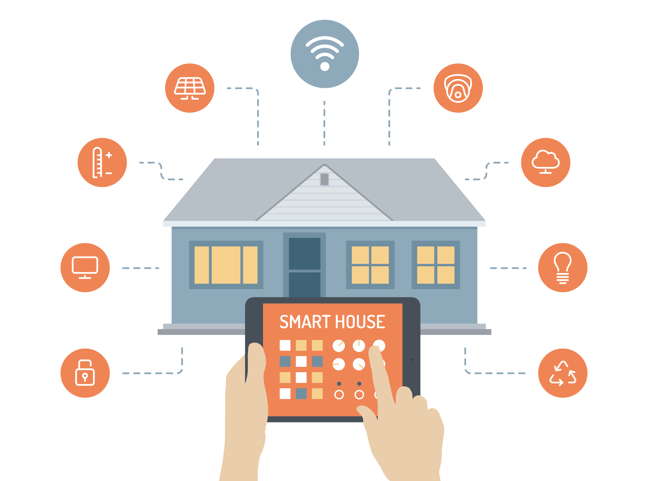

Slide 10
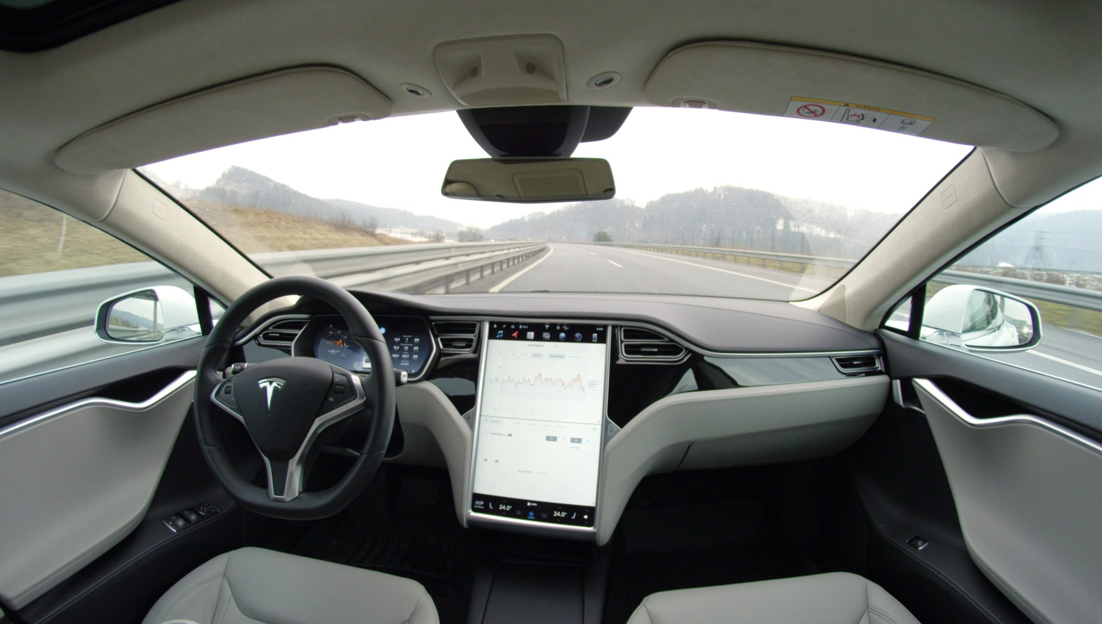
Travel Assistance

Slide 11
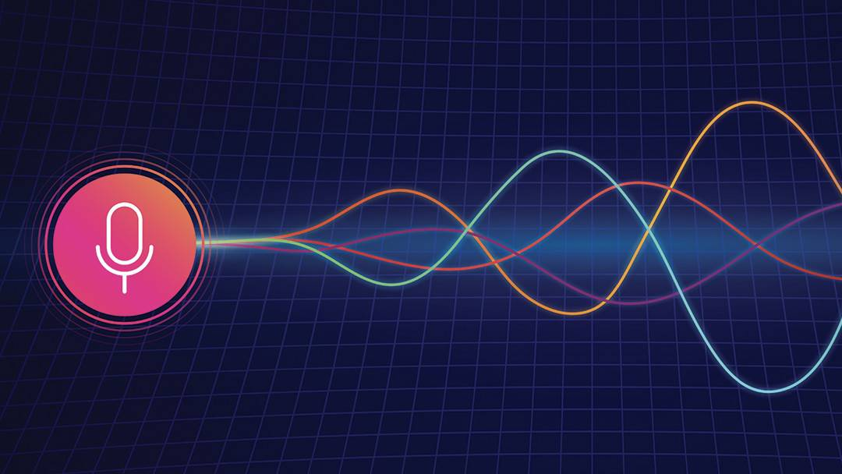
Smart Voice Assistants

Slide 12
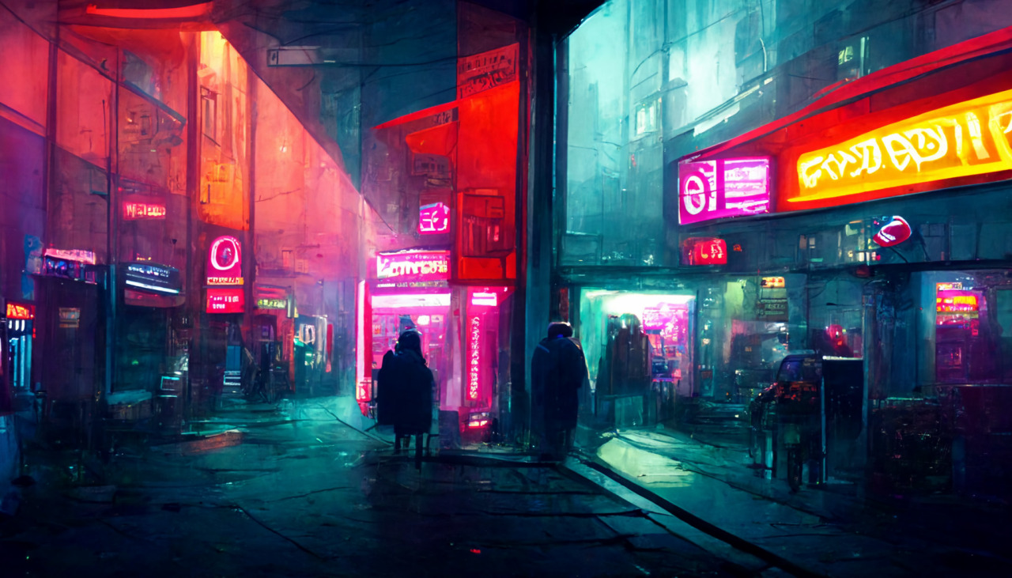
AI content generators

Slide 13
