Slide 1
Achievements in project implementation, challenges and future plans of the project
IESED
Co-funded by the Erasmus+ Programme of the European Union

Slide 2
Qualitative analysis of the upgraded study programme Engineering-Psychological Maintenance of Information Technologies introduced to the university community, social partners, local regional and national authorities

Slide 3
WP6.2. UPGRADING THE SYLLABUS WP6.3. PREPARATION OF NEW COURSE DESCRIPTIONS
No | Courses | ECTS | Hours | Completeness
1. | Psychology of Information Perception (BSUIR+BSPU) | 3 | 82 | 100% in compliance with the national legislation in education and requirements of EU experts
2. | Management of IT Projects (BSUIR+BSPU) | 3 | 82
3. | Multimedia Creation and Processing Technologies (BSUIR+SBMT BSU) | 6 | 164
4. | Software development for mobile devices | 5 | 136
5. | Programming Technologies (BSUIR+VSTU) | 7 | 190
6. | Technology of Design 3D Objects | 4 | 108
7. | Object-oriented programming (BSUIR+VSTU) | 9 | 246
 | Total: | 37 (23) | 1008

Slide 4
WP6.4. PREPARATION OF TEACHING MATERIALS
No | Courses | ECTS | Hours | Completeness
1. | Psychology of Information Perception (BSUIR+BSPU) | 3 | 82 | 85%
2. | Management of IT Projects (BSUIR+BSPU) | 3 | 82 | 80%
3. | Multimedia Creation and Processing Technologies (BSUIR+SBMT BSU) | 6 | 164 | 65%
4. | Software development for mobile devices | 5 | 136 | 65%
5. | Programming Technologies (BSUIR+VSTU) | 7 | 190 | 70%
6. | Technology of Design 3D Objects | 4 | 108 | 65%
7. | Object-oriented programming (BSUIR+VSTU) | 9 | 246 | 80%
 | Total: | 37 (23) | 1008

Slide 5
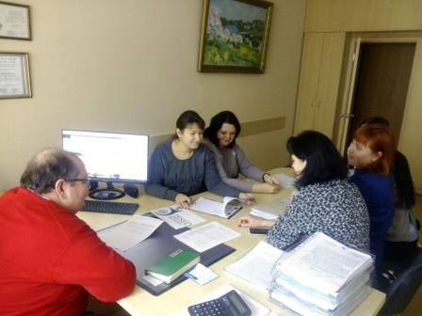
WP6.5. ACQUISITION OF TECHNICAL EQUIPMENT
Equipment for 2 Laboratories has been acquired:
Usability Testing Laboratory
3D Modelling Laboratory
Full Sum: 129781 BYN (52657,8 €)
Supplier: Batsheva Family LLC
Meeting of the Procurement Center

Slide 6
WP6.5. ACQUISITION OF TECHNICAL EQUIPMENT
Tobii EyeX
Tobii T120 Eye Tracker Personal Computer based on Intel Core i5
Personal Computer based on Intel Core i9
Monitor
Corded USB keyboard
Corded USB mouse
Speakers
Headset with microphone
Web-camera
Microphone
Stationary camera
One-way mirror
Tablet pc (2)
Laptop
3D-printer
3D-scaner
Printer
VR-headset
3D-monitor
Supplies for printer
Supplies for 3D-printer
MicroSDHC cards
Ultrasound sensor
Battery
Wi-Fi adapter
USB Bluetooth adapter

Slide 7
WP6.6. TRIAL PROGRAMME REALISATION
No | Courses | ECTS | Hours | Year, Semester | Completeness
1. | Psychology of Information Perception (BSUIR+BSPU) | 3 | 82 | 2, spring | 100%
2. | Management of IT Projects (BSUIR+BSPU) | 3 | 82 | 3, spring | 100%
3. | Multimedia Creation and Processing Technologies (BSUIR+SBMT BSU) | 6 | 164
4. | Software Development for Mobile Devices | 5 | 136
5. | Programming Technologies (BSUIR+VSTU) | 7 | 190
6. | Technology of Design 3D Objects | 4 | 108
7. | Object-Oriented Programming (BSUIR+VSTU) | 9 | 246
 | Total: | 37 (23) | 1008

Slide 8
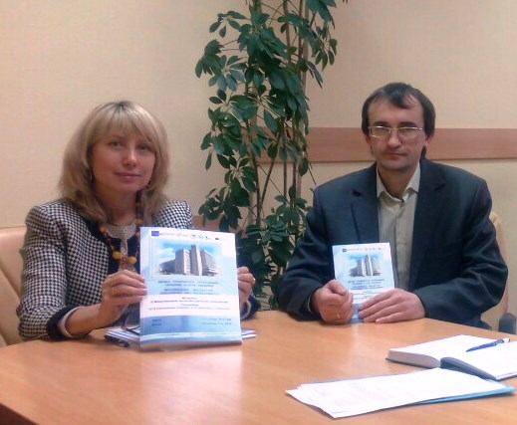
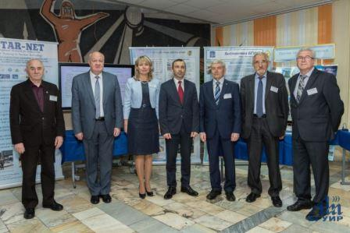
Visibility and dissemination
Via publications and meetings with stakeholders
The IX International Scientific and
Methodical Conference “Higher Technical Education: Problems and Ways of Development” (November 01-02, 2018)

Slide 9
Feedback from employers
EMPLOYERS HAVE TAKEN PART IN THE DEVELOPMENT OF 7 STUDY PROGRAMME DESCRIPTIONS AND HAVE REVIEWED TWO TRIAL ONES: PSYCHOLOGY OF INFORMATION PERCEPTION (BSUIR+BSPU) AND
MANAGEMENT OF IT PROJECTS (BSUIR+BSPU)

Slide 10
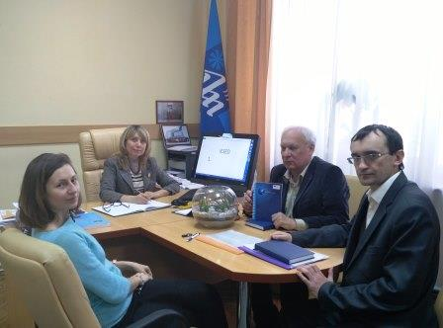
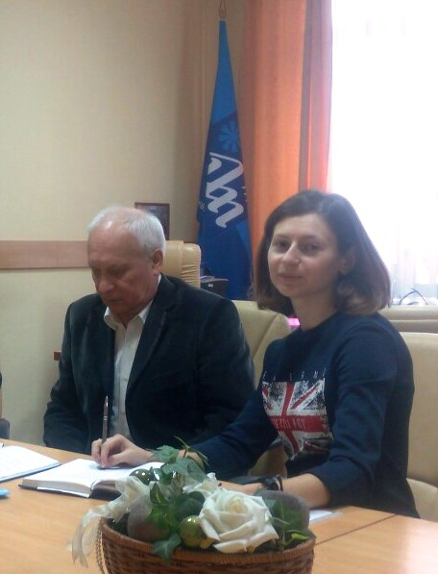
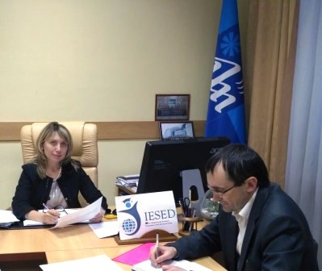
Management and QUALITY CONTROL
REGULAR MEETINGS WITH THE WORKING GROUP

Slide 11
Next steps
WP7.1. EXPERT ASSESSMENT OF STUDY PROGRAMMES
WP7.2. EXPERT ASSESSMENT OF TEACHING MATERIALS
WP7.3. ADAPTATION OF LEARNING MATERIALS FOR E-LEARNING
in consultation with potential employees

Slide 12
Thank you!
HELENA ZHIVITSKAYA
VICE-RECTOR FOR EDUCATION
ELENA DENISSOVA
INTERNATIONAL RELATIONS OFFICE
Bydgoszcz (Poland), 2019

