Slide 1
Insights into the achieved results, challenges and future plans of the project
IESED
Co-funded by the Erasmus+ Programme of the European Union

Slide 2
IESED: IMPACT AT BSUIR
WP1: Research of Competencies of IT Specialists and Improvement of Teachers’ Qualification Based on European Experience
WP6: Upgrading of Informatics Study Programme
WP7: Expertise of Study Programmes
WP8: Project Quality Management
WP9: Dissemination and Exploitation
SUSTAINABILITY

Slide 3
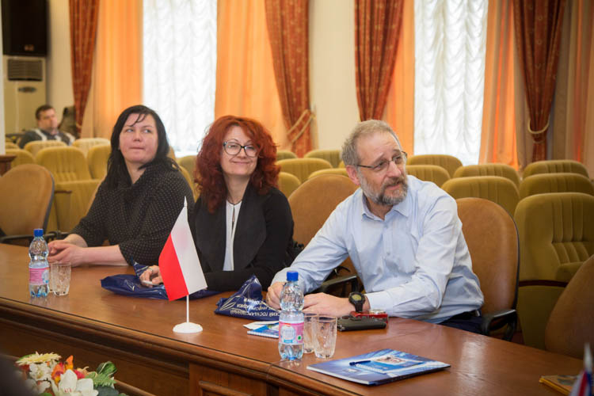
WP1.1. RESEARCH OF IT SPECIALIST COMPETENCY
Practical seminar “Synthesis of Competencies and Technologies in IT Specialist Training” (April 05-06, 2017 in Minsk, BY)
Outputs: A list of IT specialist competencies reviewed in the context of education and labour market in Belarus

Slide 4
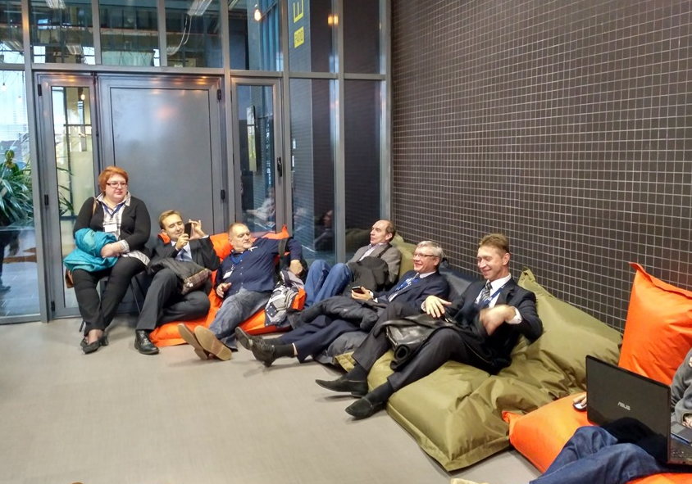
WP1.1. RESEARCH OF IT SPECIALIST COMPETENCY
Practical seminar “Modeling of IT Specialist Profile” (October 22-26, 2017 in Lille, FR)
Outputs: IT specialist profile formed in correspondence with the needs of both national and international labour market

Slide 5
IT specialist profile
Performs comprehensive testing of the developed software products and applied software
Builds and optimizes models of various systems and processes
Analyzes perspectives and directions of development of information systems and technologies
Applies basic scientific and theoretical knowledge to solve practical problem
Plans and organizes automated support of various activities
Performs modeling, design of software tools and documentation to support activities in various subject areas
Generates new ideas focusing on creativity, critical thinking, communication and collaboration
Develops data structures for use in information systems, operational analysis systems and intellectual systems

Slide 6
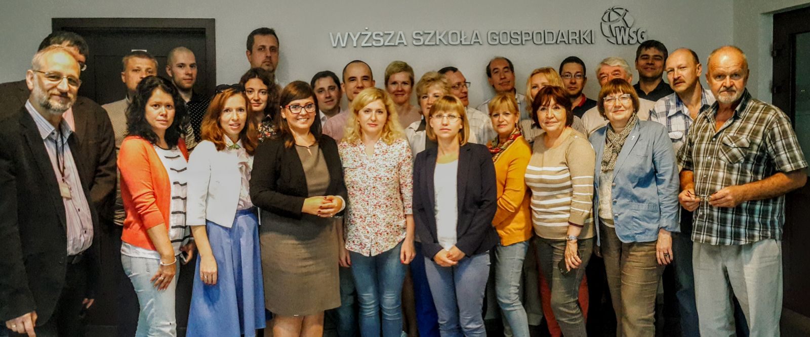
Wp1.2. improvement of belarus hei teachers’ qualifications based on european experience
English language courses (June-December 2017 in Minsk, BY)
Internship “Innovative Study Methods” (July 17-28,
2017 in Bydgoszcz, PL)

Slide 7
Outputs
New knowledge of such innovative study methods as:
New knowledge on:
Practice of the English language for academic purposes
using robots;
using instant messengers;
using games (gamification);
using teleconferencing;
using blended learning in the study process
Bologna process characteristics and implementation in Poland;
Erasmus + program characteristics and opportunities;
Polish education system structure and functioning on the university level

Slide 8
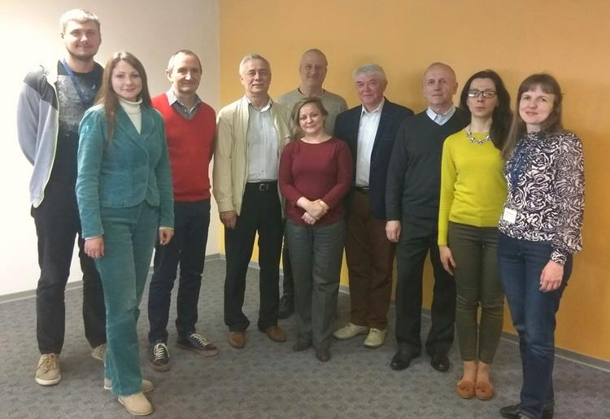
Wp1.2. improvement of belarus hei teachers’ qualifications based on european experience
Internship “IT Theory, Innovative Methods and Practice” (April 9-13, 2018 in Lille, FR)
Outputs: New knowledge of IT technologies and tendencies of their use in the study process

Slide 9
Impact
Conception of ICT Education Development in BY:
Developed by BSUIR (the leading ICT university in BY) BSU, BNTU, Ministry of Education, Ministry of Communications and Informatisation, Academy of Sciences and Hi Tech Park.
Reviewed by 23 Belarusian HEIs
March 2018: presented at the joint meeting of the Ministerial boards, Hi Tech Park administration and 530 representatives of BY educational system
May 15-18, 2018: presented at the 25th International ICT Forum TIBO (Minsk)
Final approval is pending

Slide 10
impact
“Univesity 3.0” model :
Came in effect as the Experimental innovative activity project on July 26, 2018 following the Order of the Minister of Education
Includes Republican Institute of Higher Education, BSUIR, BSU, BNTU, BSEU, BSTU, Yanka Kupala State University of Grodno and Belarusian-Russian University
Roadmap for Year 1 includes the modernization of course documentation
Read more: https://www.bsuir.by/ru/news/101011-model-universitet-3-0--po-itogam-kollegiya-ministerstva-obrazovaniya-respubliki-belarus-

Slide 11
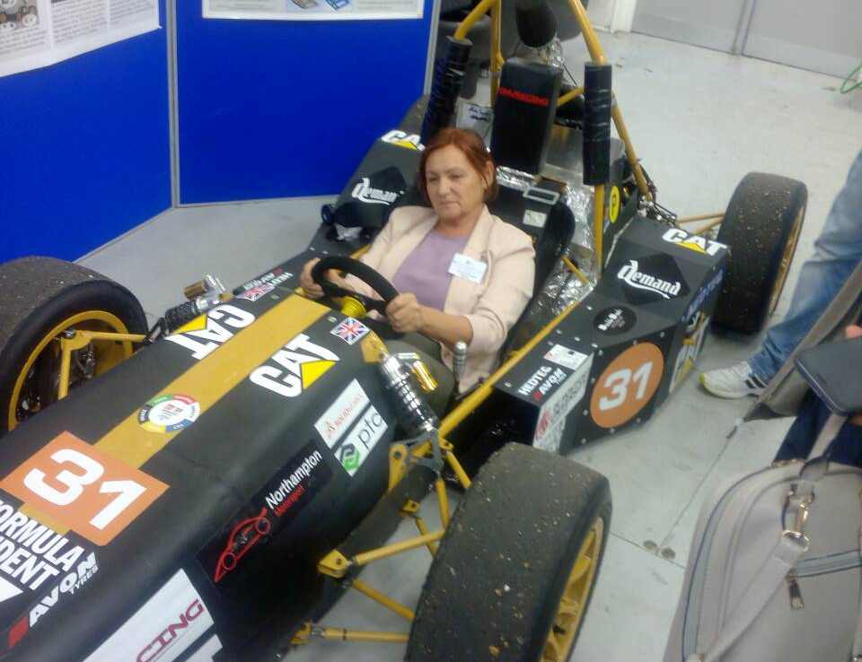
Wp1.2. improvement of belarus hei teachers’ qualifications based on european experience
Internship “IT in the Context of Intercultural Competency”
(September 16-22, 2018
in Leicester, UK)
Outputs: Intercultural competency of teachers, who train IT specialists, which is developed via experiential learning in a multicultural context

Slide 12
WP6: Upgrading of Informatics* Study Programme
WP6.1. UPGRADING GOALS AND OUTCOMES OF THE STUDY PROGRAMME
WP6.2. UPGRADING THE SYLLABUS
WP6.3. PREPARATION OF NEW COURSE DESCRIPTIONS
WP6.4. PREPARATION OF TEACHING MATERIALS
WP6.5. ACQUISITION OF TECHNICAL EQUIPMENT
WP6.6. TRIAL PROGRAMME REALISATION
* Correct: Engineering-Psychological Maintenance of Information Technologies

Slide 13
GOALS AND OUTCOMES OF THE STUDY PROGRAMME “Engineering-Psychological Maintenance of Information Technologies”
To teach students to:
conduct systems analysis and define engineering and psychological requirements to the information and technical systems;
make engineering and ergonomic evaluation and design of software and hardware.

Slide 14
Outcomes according to Dublin Descriptors
Apply basic scientific and theoretical knowledge to solve practical problem K (1)
Develop data structures for use in information systems, operational analysis systems and intellectual systems P (2)
Perform modeling, design of software tools and documentation to support activities in various subject areas P (3)
Perform comprehensive testing of the developed software products and applied software P (4)
Design interfaces and provide ergonomic evaluation of information systems P (5)
Analyze perspectives and directions of development of information systems and technologies R (5)
Work independently and in a team S (6)
Generate new ideas focusing on creativity, critical thinking, communication and collaboration. S (7)
K – knowledge, P – professional skills, R – research skills, S – social skills

Slide 15
Table 1. Updated learning outcomes
Subjects | Study program learning outcomes
 | 1 | 2 | 3 | 4 | 5 | 6 | 7 | 8
Professional English |  |  |  | + |  |  | +
Object-oriented programming |  |  | + |  |  | +
Computer networks |  |  |  |  |  | + | +
Web technologies |  |  | + |  |  |  | +
Programming Technologies |  |  | + |  |  |  | +
Law in the field of information technology | + |  |  |  |  |  |  | +
Intellectual property in IT |  |  |  |  |  | + |  | +
Psychology of information perception |  |  |  | + | + |  |  | +
Software design for mobile devices |  |  | + |  | + |  | +
Technologies Of Designing 3-D Objects | + |  |  |  |  |  |  | +
Multimedia creation and processing technologies |  |  |  |  | + | + | +
IT project management |  |  | + |  |  |  |  | +

Slide 16
WP6.2. UPGRADING THE SYLLABUS
22% of the study programme will be new (12 courses, 57 ECTS)
No | Courses | ECTS
1 | Law in the IT-sphere | 3
2 | Intellectual Property and Protection of Information | 3
3 | Psychology of Information Perception | 3
4 | Management of IT Projects | 3
5 | Multimedia Creation and Processing Technologies | 6
6 | Computer Networks | 3
7 | Web Technologies | 3
8 | English for Specific Purposes | 8
9 | Software development for mobile devices | 5
10 | Programming Technologies | 7
11 | Technology of Design 3D Objects | 4
12 | Object-oriented programming | 9
 | Total: | 57

Slide 17
WP6.3. PREPARATION OF NEW COURSE DESCRIPTIONS
9 new course descriptions:
Software Development for Mobile Devices (BSUIR)
Technology of 3D Objects Design (BSUIR)
Psychology of Information Perception (BSUIR+BSPU)
Management of IT Projects (BSUIR+BSPU)
Multimedia Creation and Processing Technologies (BSUIR+SBMT BSU)
Object-Oriented Programming (BSUIR+VSTU)
Programming Technologies (BSUIR+VSTU)

Slide 18
Pending…
WP6.4. PREPARATION OF TEACHING MATERIALS
WP6.5. ACQUISITION OF TECHNICAL EQUIPMENT
WP6.6. TRIAL PROGRAMME REALISATION

Slide 19
Next steps
WP7.1. EXPERT ASSESSMENT OF STUDY PROGRAMMES
WP7.2. EXPERT ASSESSMENT OF TEACHING MATERIALS
WP7.3. ADAPTATION OF LEARNING MATERIALS FOR E-LEARNING
All materials are peer reviewed by potential employers

Slide 20
WP9: Dissemination and exploitation
Project page https://www.bsuir.by/ru/iesed
Project website http://iesed.esy.es/
Student involvement

Slide 21
WP9: Dissemination and exploitation
IX International Scientific and Methodical Conference “Higher Technical Education: Problems and Ways of Development” (November 01-02, 2018)
https://www.bsuir.by/ru/mnmk2018
Publications:
Zhivitskaya, E.N. Information system for the training of IT-specialists / Zhivitskaya E. N., Danilova G. V. // Computerization of education. - 2017. - No. 1 (79). - pp. 54-72.
Zhivitskaya E.N., Arkhipova L.I., Knyazeva L.P., Marakhina I.V., Parhimenko V.A. / Training of specialists in the field of electronic marketing: personnel for the digital economy of the Republic of Belarus. / Journal of Research and Practice “Digital Transformation” No. 1, December 2017. pp. 38-44. ISSN 2522-9613.
Zhivitskaya, E.N. Use of information and communication technology by people with disabilities for overcoming the digital divide / E. N. Zhivitskaya, A. A. Okhrimenko // Information systems and technologies: proceedings of the 5th International Scientific and Technical Conference, (Kharkiv, September 12-17, 2016): abstracts of the reports / [editorial board: A.D. Tevyashev (executive editor)]. - Kharkov.: Publishing House Madrid, 2016. - pp. 208-210.

Slide 22
WP9: Dissemination and exploitation
Publications (cont.):
Zhivitskaya, E.N., Lysenya, A.A. Benchmarking in the system of improving the education quality management of higher education institutions./ E.N. Zhivitskaya, A.A. Lysenya // Engineering education: challenges and developments: proceedings of the VIII International Scientific and Methodical Conference, Minsk, November 17-18, 2016. in 2 volumes, volume 1 / editorial board: E.N. Zhivitskaya and others - Minsk: BSUIR, 2016. - pp. 156-159.
Zhivitskaya E.N., Smirnov V.L., Fetskovich D.A. Current state, challenges and trends of development of practice-oriented training of specialists with higher education. / Proceedings of the X International Scientific and Methodological Conference "Distance learning is educational setting of the XXI century”. Minsk, December 7-8, 2017. ISBN 978-985-543-381-2 pp.37-39.
Zhivitskaya E.N. , Alyabyeva I.I.. MODERN TRENDS OF DEVELOPMENT OF INFORMATION AND COMMUNICATION TECHNOLOGIES IN HIGHER EDUCATION IN THE REPUBLIC OF BELARUS. VYSSHAYA SHKOLA: CHALLENGES AND PROSPECTS <https://elibrary.ru/item.asp?id=34906121> Proceedings of the 13th International Scientific and Methodological Conference. In 3 volumes. 2018 pp. 192-198.
L.Vainshtein, V.Osipovich, E.Melnikova, N.Shcherbina, K.Yashin. Engineering Psychology and Ergonomics in the Educational Period// Vysheishaya shkola, 2018, No.3 (125), pp. 33–38;

Slide 23
Sustainability strategy
Student intake: 120 Belarusian + 40 foreign/ 4 years
On-line courses: 12
Agreements with businesses regarding students’ internships: EPAM Systems, Itransition Group, System Technologies, Light Well Organization, Horizont Center for Research and Development, GlowByte Consulting, SaM Solutions, Altoros Development, Nextsoft, Oxagile, Godel Technologies
Reaching IT course providers–companies in Belarus: EPAM Systems, Itransition Group, A1QA, IBA Group, Belhard IT Academy, Stormnet
Reaching business associations: International specialized exhibition “Education & Career”
Development of strong links and cooperation (in research activities/IT field) outside of the project partnership: Uzbekistan (2), Kazakhstan (1) – Joint Study Programmes, EU (Slovakia, Germany, UK, Poland), Russia, etc. – lecturing, invited teachers
Expertise in order to apply for other EU funded programmes /projects: A new project under Erasmus+ programme Capacity Building in Higher Education (February 2019)
Mobility of students and teachers: state scholarships, Erasmus+ programme project KA107

Slide 24
Thank you!
ELENA DENISSOVA
INTERNATIONAL RELATIONS OFFICE
Leicester (the UK), 2018

