Slide 1
Young people’s problems
BELARUSIAN STATE UNIVERSITY OF INFORMATICS AND RADIOELECTRONICS
Student Pavel Gorokh
Group 711802
Minsk 2017

Slide 2
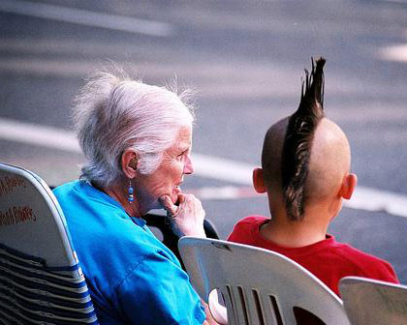
Generation Gap

Slide 3


Is it easier to be an adult or a teenager?
Earn money
Bring up children
Do teenage things/act like a baby
Depend on your parents
Have pocket money
Go to school
Ask permission
Personally I think it’s easier to be а teenager because you…

Slide 4
friends
school
Youth problems
What can make you nervous, annoyed, disappointed?
Clothes/fashion
Problems at school
Problems with parents
A quarrel with friends
Lack of caring
Too much control
Falling in a difficult
situation

Slide 5




Read the teenager’s letters published in a youth magazine. Give them advice.
Hi. My name is Helen. I’m 16.
I have a problem with my mum.
She doesn’t like my boyfriend. She
doesn’t trust him and doesn’t let me
to hang out with him. I’d like that
my mum respect my choice. I’m not
a child any more!
My name’s David. Recently I changed
my school and now I have problems with
my new classmates. They always make fun
of me and teas me because of my nationality.
It’s too difficult for to adapt.
Hello! I’m Nora. My dad
And mum are ok, but they
have too much control
over me and I lack of privacy.
When I go out with friends,
I always have to be back home
by 10 p.m. I have to ask
permission for everything.
It doesn’t fair.
Hi! I’m Jess. My father forgot about me!
I understand that it’s very difficult to find a well-
paid job. My dad has one and he has to work hard and little
time is left to spend with me. I don’t even remember when
he talked to me last time. It’s not right I think!

Slide 6
Teachers and students, parents and children, strangers in the streets face the problem of generation gap every day.
What do parents do wrong, according to teens’ opinions? Parents… …want to protect …think they know life better …forbid …treat like a baby …make children do… …care too much …think for their children … give a lot of advice …treat badly | What do young people want? Teenagers want to… …enjoy life … be independent …be taken seriously … explore life by themselves …have a chance to… …have the right to… | How do their arguments influence their life? Their arguments turn into… …misunderstanding … fights and even cold wars …arguments It makes life … … unbearable …difficult

Slide 7

Ideal Family
Ideal
children
Ideal
parents

Slide 8

Internet addiction

Slide 9

Types of Internet addiction
web surfing
chat rooms/online dating/ social networking
gaming (video/computer) and online gambling

Slide 10

What activities do your prefer in your spare time?

Slide 11


Symptoms
Dry eyes
Headaches
Back aches
Loss of appetite
Sleep disturbances
Neglecting family and friends
Feeling depressed without a computer
School and job problems
Inability to stop using a computer

Slide 12
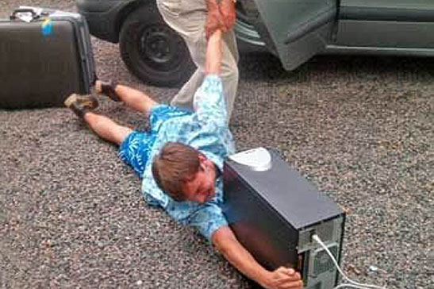
What is “Internet addiction”?
Mental disorder
Obsessive desire to connect to the Internet
Painful inability to timely disconnect from the Internet

Slide 13
Symptoms of the teenagers
(according to the survey)

Slide 14

Physical side-effects
Sleep depravation
Risk of carpal tunnel syndrome
Back strain
Eyestrain
Headaches

Slide 15
Consequences of using the computer

Slide 16
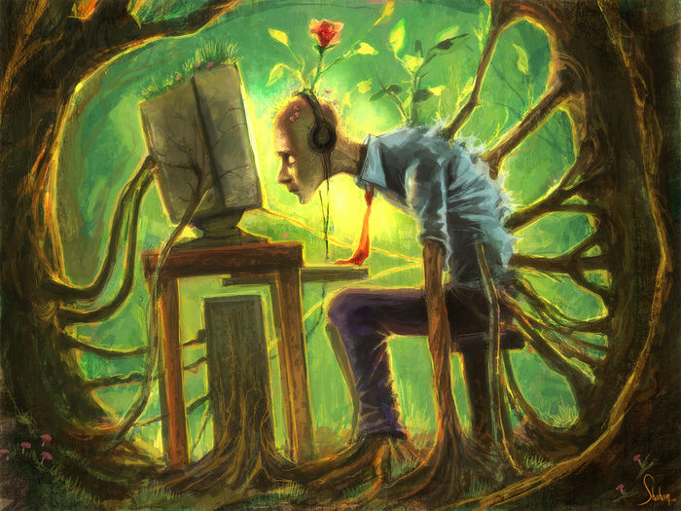
Conclusion
Computer addiction is one of the main teenagers’ problems

Slide 17

Thank you for your attention

