Slide 1
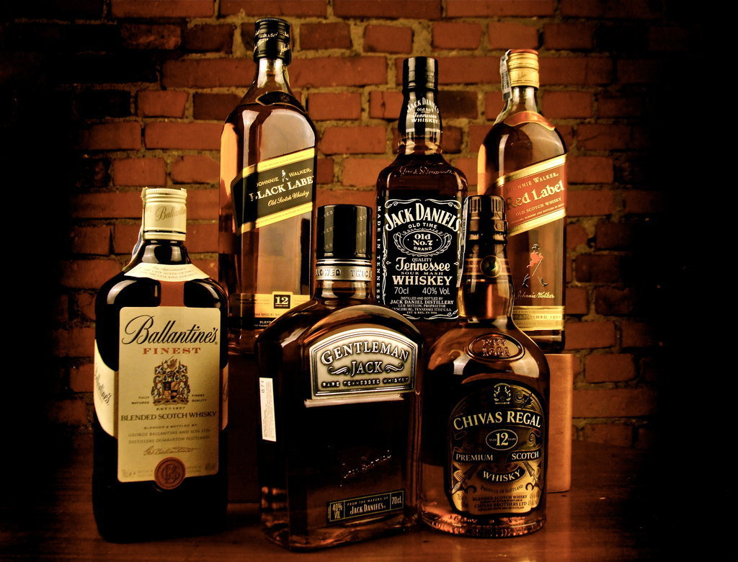
Alcohol :
Pleasures and Problems

Slide 2
Why is this issue important?
For years, alcohol has been a part of social gatherings, celebrations, and rituals. Addiction to alcohol is more of a problem today than it has ever been in the past. Unlike a century ago, we are now more aware of the serious complications it can cause.

Slide 3
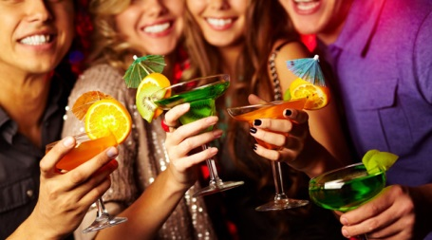
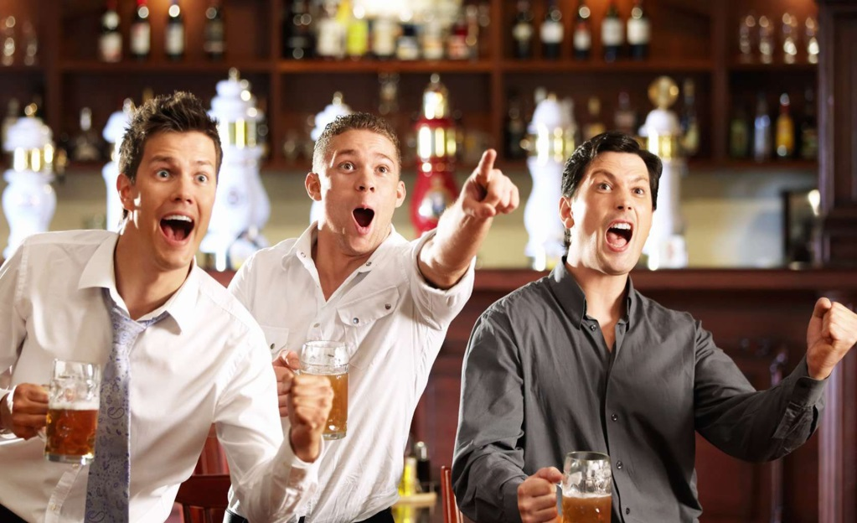
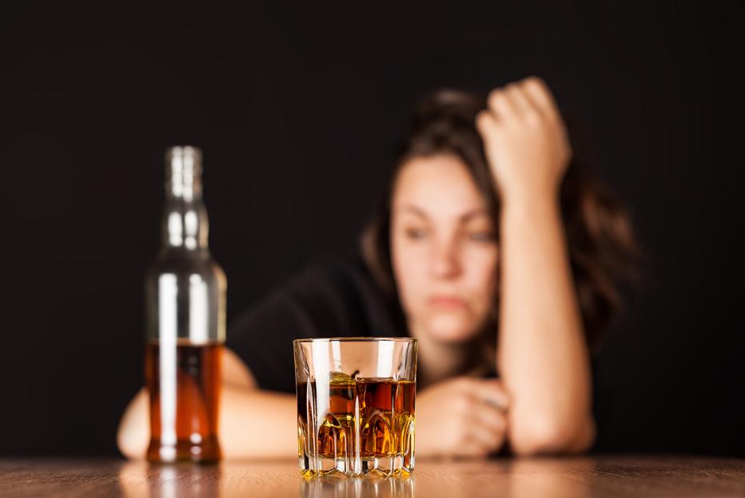
People drink alcohol to…
Feel more relaxed
Look cool
Forget problems
Join the party
Have fun during the holidays
Enjoy sporting events
Become intoxicated

Slide 4
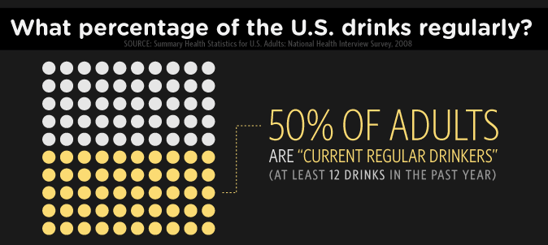
How many people do you think that drinks alcohol?

Slide 5
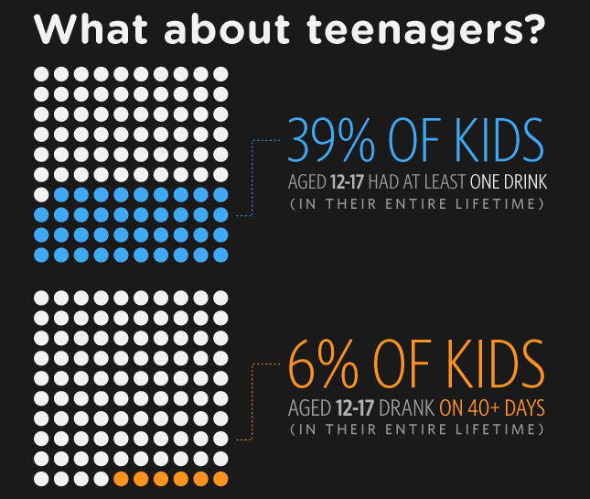
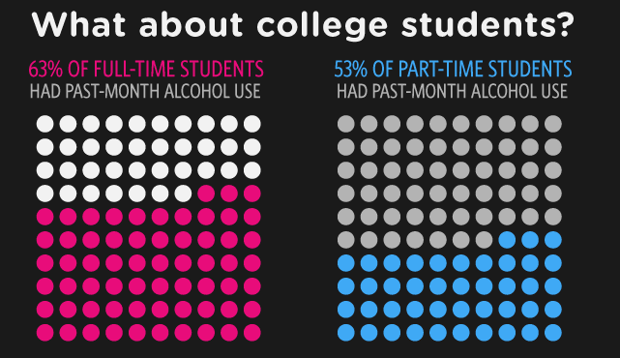
What about Kids and students?

Slide 6
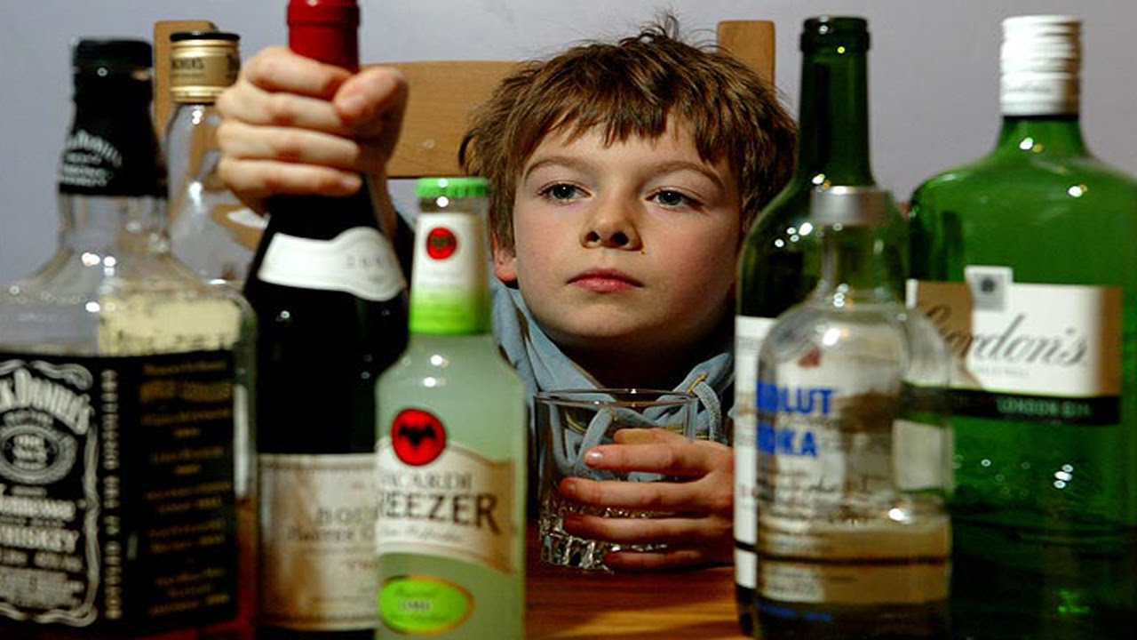
How does alcohol impact others?
Kids look up to their parents or to their siblings. When they see they are having fun drinking with their buddies or when they see an advertisement of alcohol, they’ll misunderstand the message of alcohol and think it’s good for them.

Slide 7
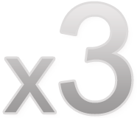
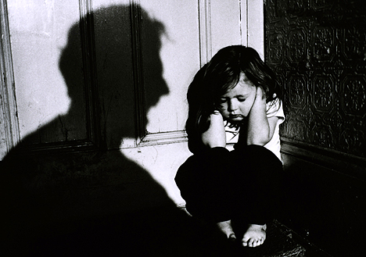
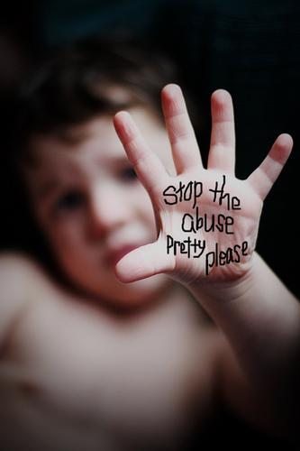
Children whose parents abuse alcohol and other drugs are three times more likely to be abused and more than four times more likely to be neglected than children from non-abusing families.

Slide 8
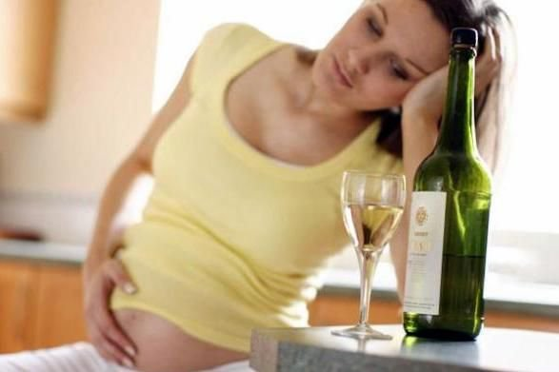
Outbursts of emotions can cause the alcoholic person to be violent and harms other people around him/her
Fetal alcohol syndrome – a serious problem that can develop in the fetus of women who drink during pregnancy

Slide 9
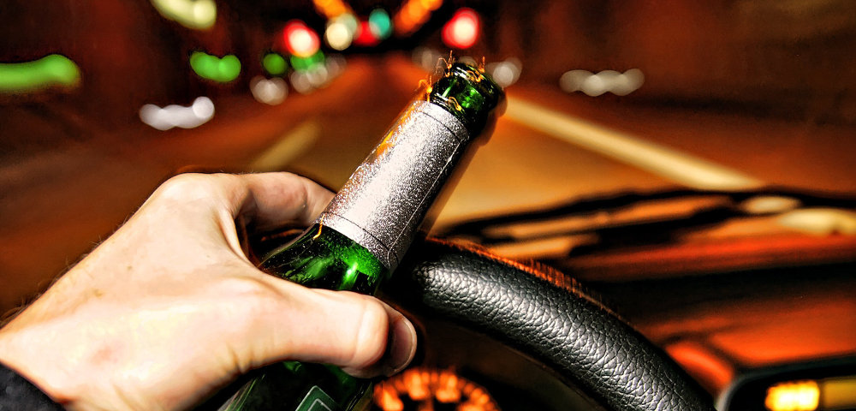
Driving while intoxicated can cause serious problems on the road. The intoxicated driver can crash on to someone else and chances are they both will die, just one of them, or by miracle… they just survive with just bruises.

Slide 10
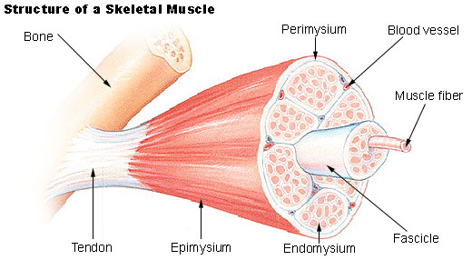
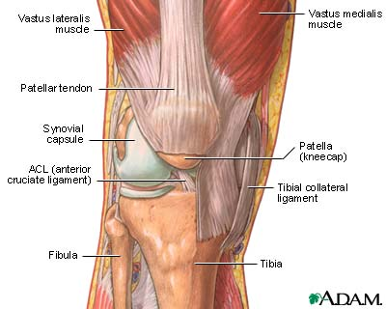
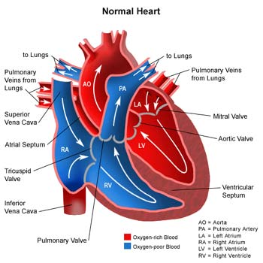
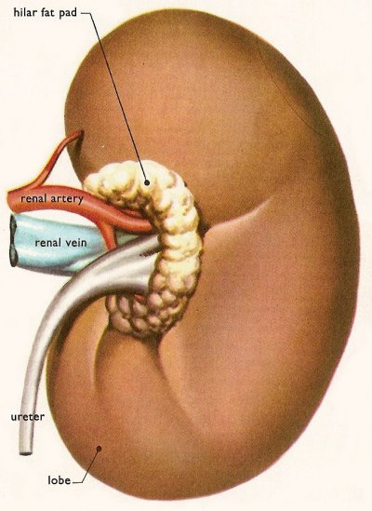
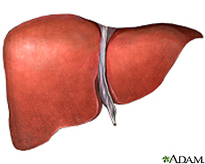
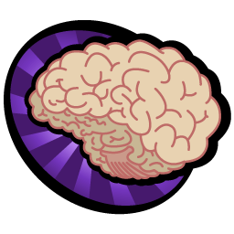
What can alcohol damage?
Heart
Brain
Joints
Liver
Kidney
Esophagus
Muscles

Slide 11
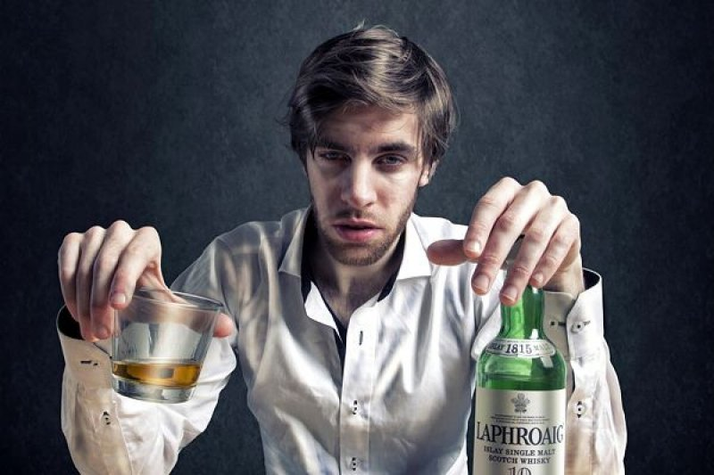
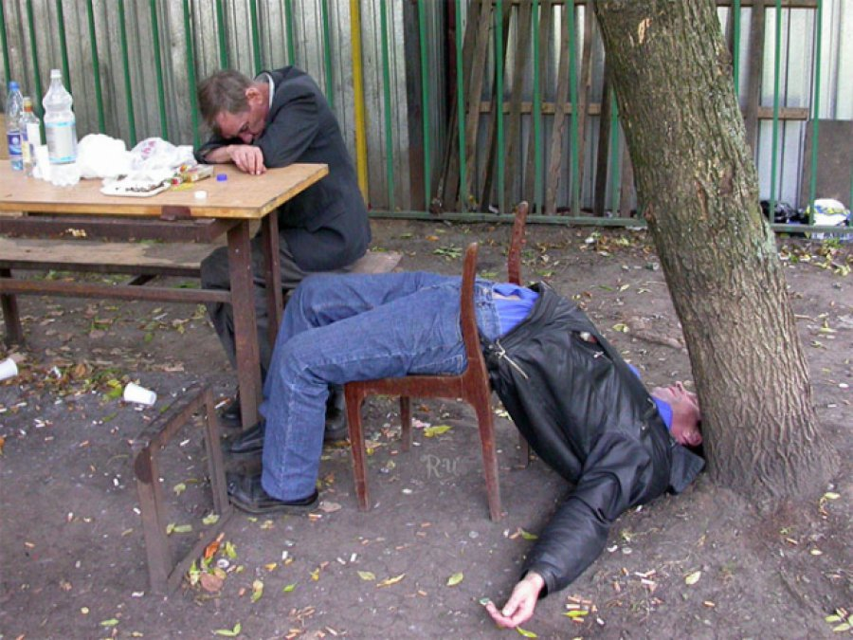
Immediate Effects
Blurred Vision
Slurred speech
Increased heart beat
Lowers body temperature
Vomiting
Hangover
Alcohol Poisoning (death)

Slide 12
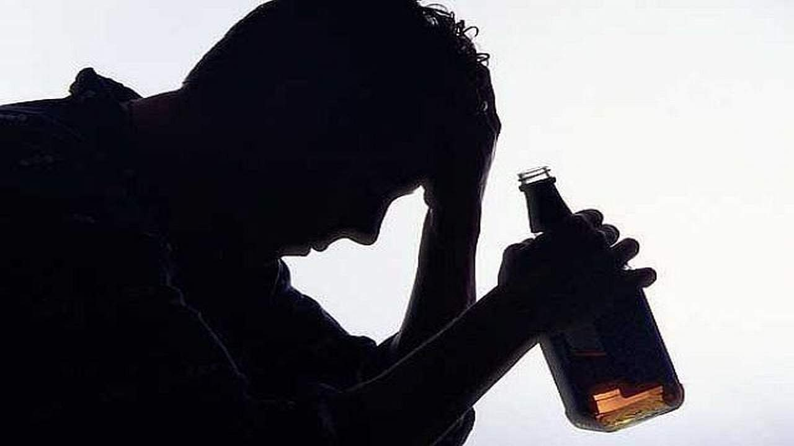
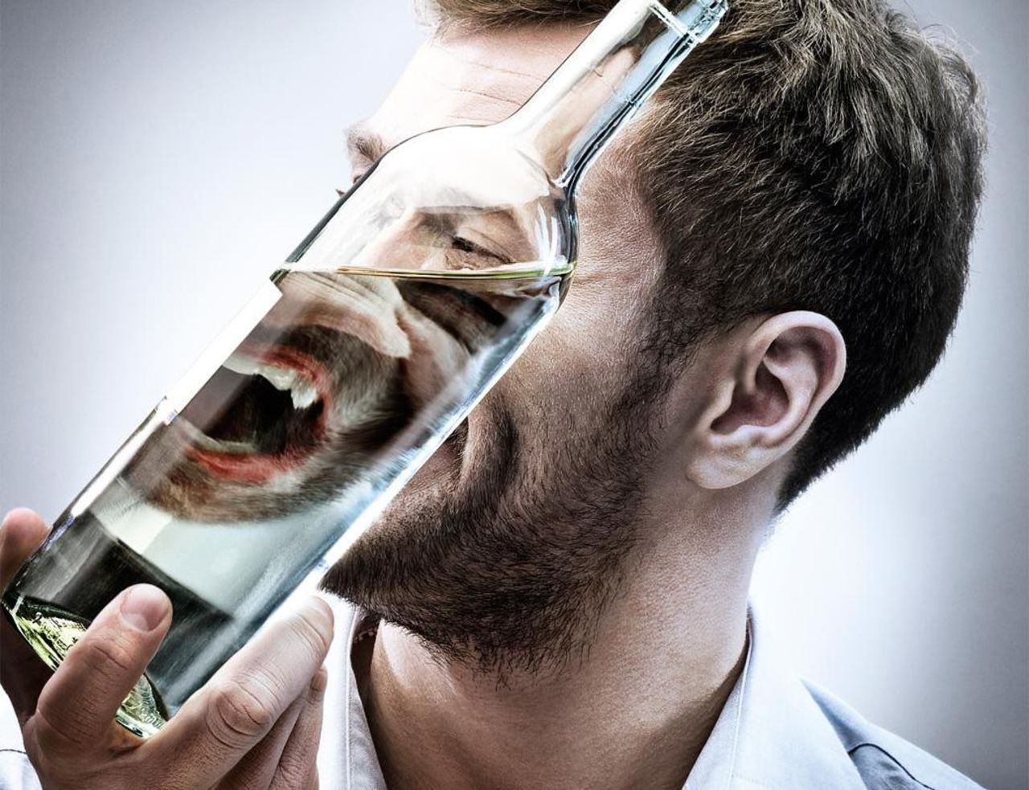
Diseases alcohol can cause
Cancer
Depression
Heart and respiratory failure
Cirrhosis
Wernicke - Korsakoff Syndrome
And many more…

Slide 13
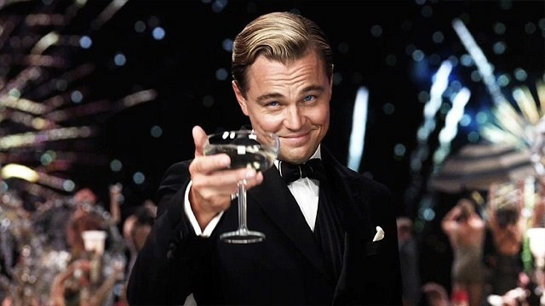
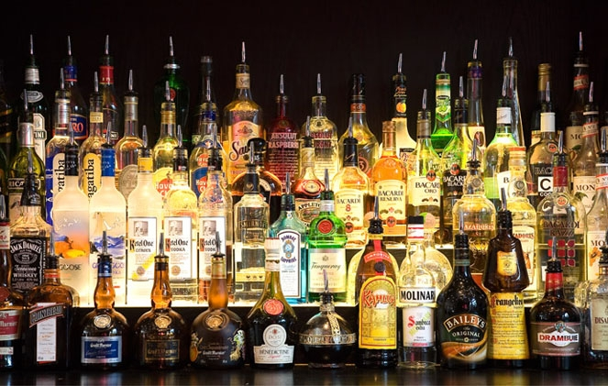
Picture of man that is affected by alcohol

Slide 14
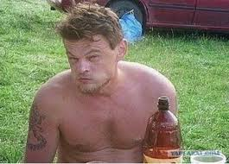

Slide 15
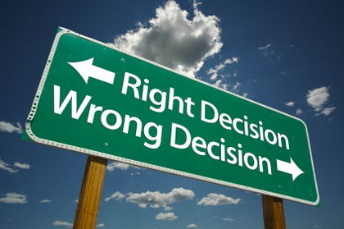
Being under the influence of alcohol makes you lose sight of what’s right or wrong.

Slide 16
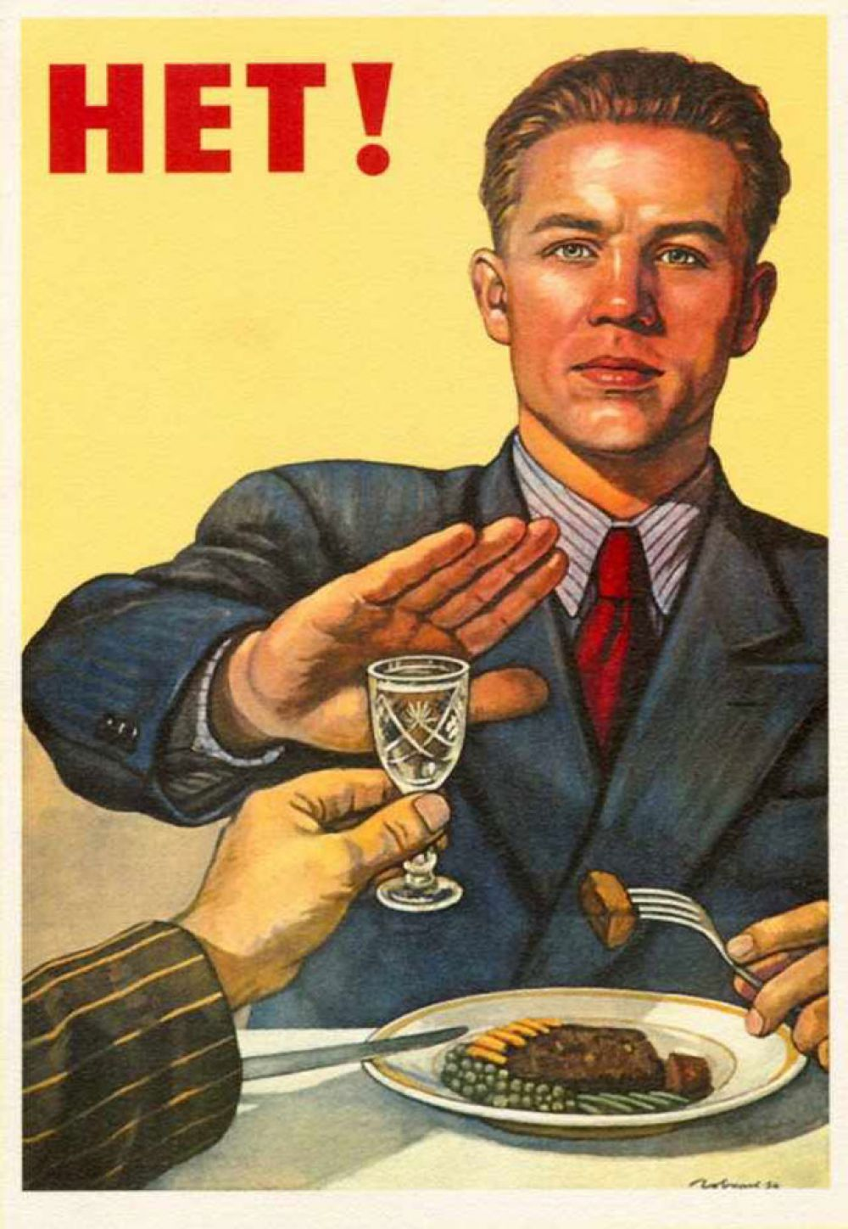
Make your choice!

