Slide 1

Computer Addiction

Slide 2
3 MAIN TYPES OF Comp.Add. :
Game addiction :)
Social Network addiction :(
Addiction from serials/films :)

Slide 3
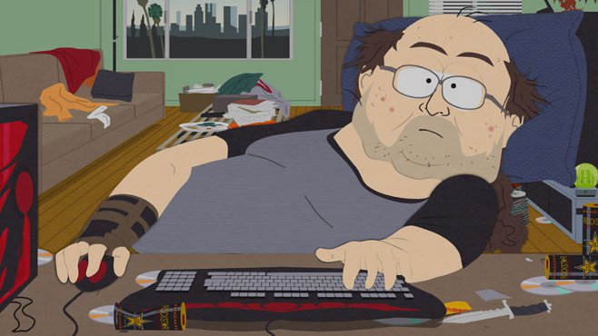
Game addiction

Slide 4



Most Popular Games

Slide 5

Social Network addiction

Slide 6


Most popular sites

Slide 7

Addiction from serials/films

Slide 8



Most popular serials

