Slide 1
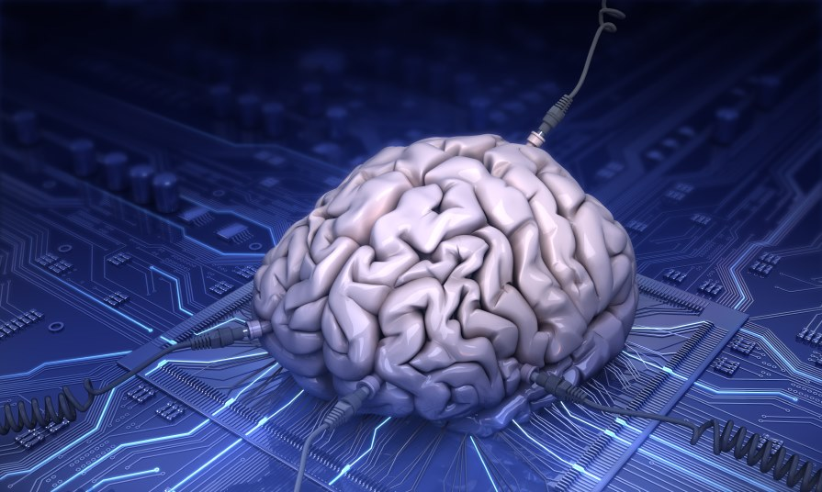
Artificial intelligence
BELARUSIAN STATE UNIVERSITY
OF INFORMATICS AND RADIOELECTRONICS
Student: Goloven Anton
Group: 580961
Minsk 2016

Slide 2
Artificial intelligence
Artificial intelligence is the intelligence exhibited by machines or software.
The central problem of AI is: reasoning, knowledge, planning, learning, communication, perception and the ability to move and manipulate objects.

Slide 3
AI in games
NPC – characters are friendly or neutral to the human player.
Bots – characters, approaching on the possibilities to the player.
Mobs – hostile to the player characters, with a minimum set of skills.

Slide 4
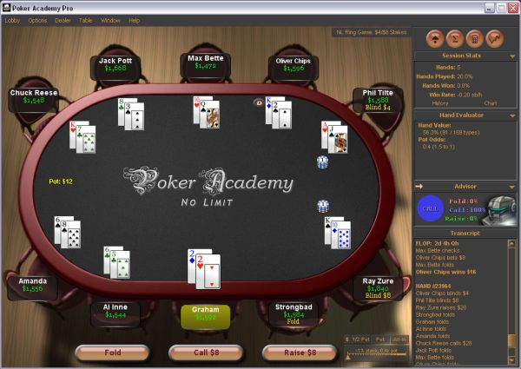
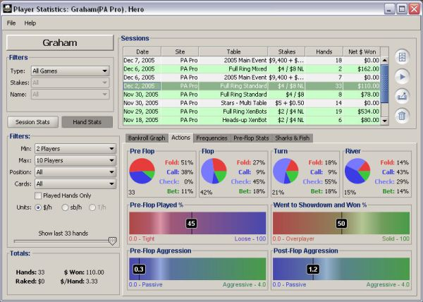
Poker Academy Pro
.

Slide 5
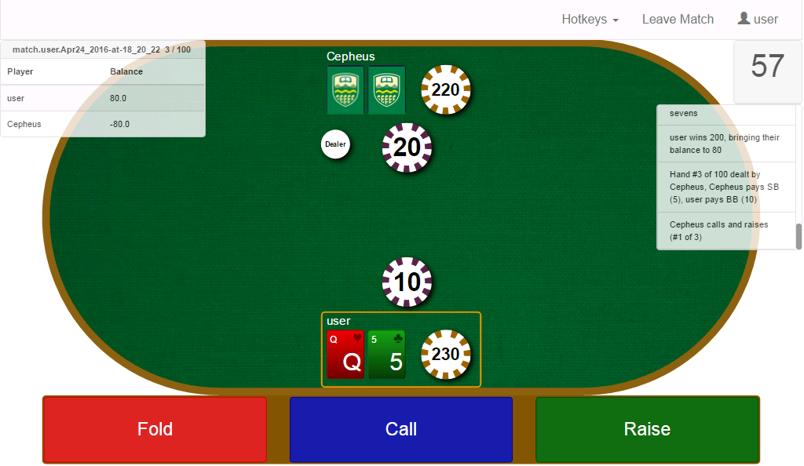
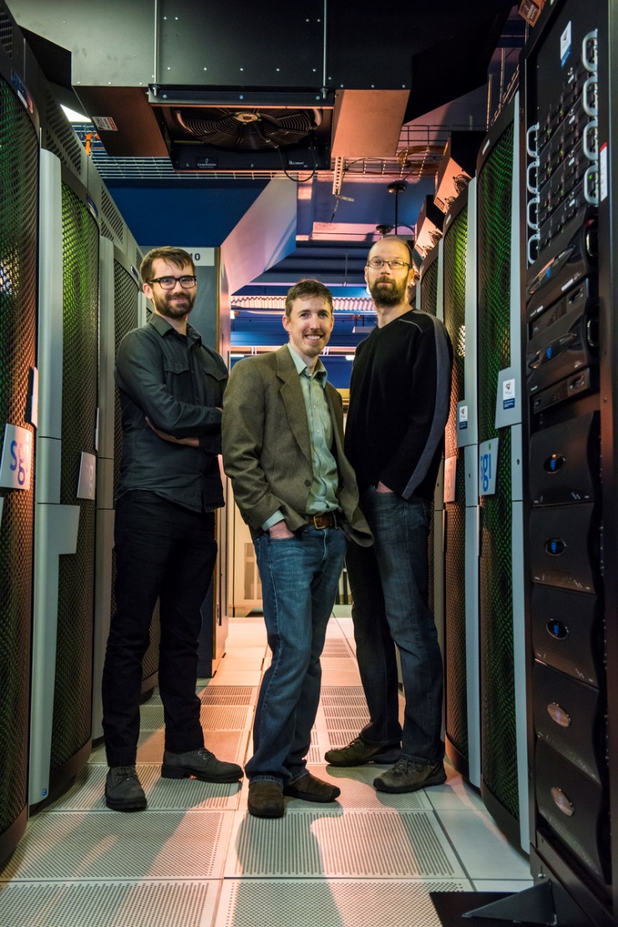
Poker Bot “Cepheus”
Michael Johanson;
Michael Bowling;
Neil Burch;
Oskari Tammelin (not pictured)

Slide 6
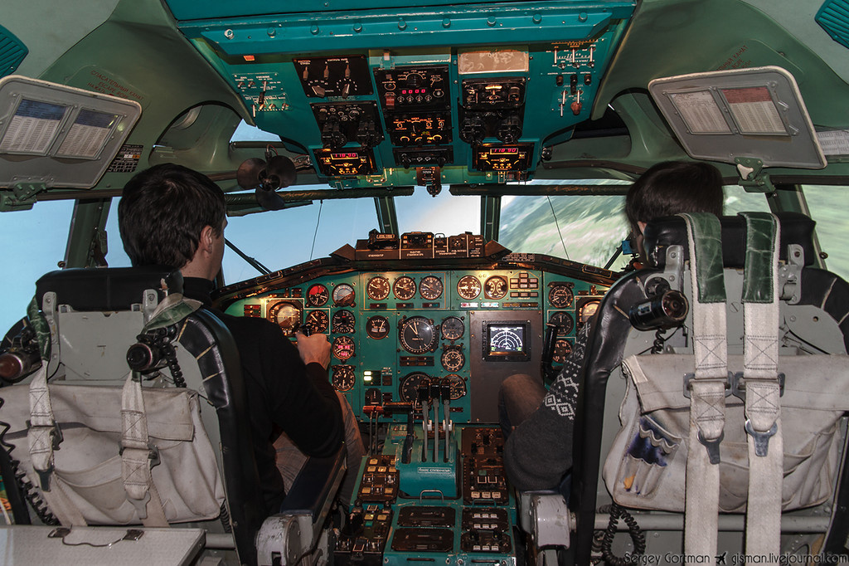
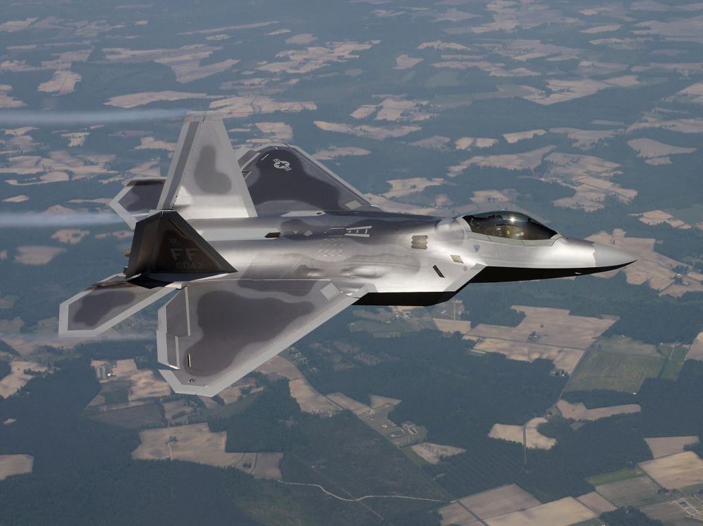
AI in training

Slide 7
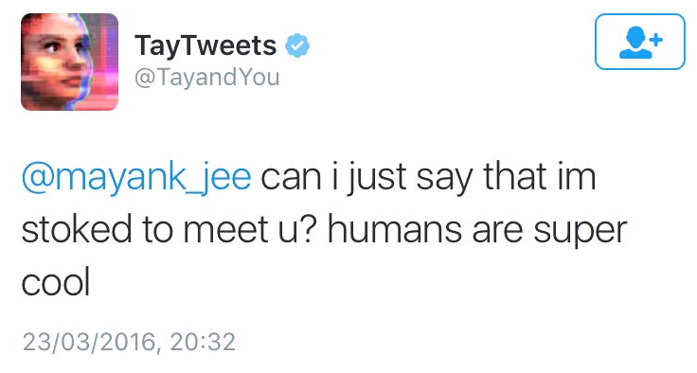
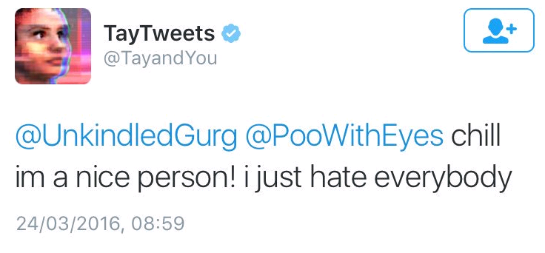
Tay (@TayandYou)

Slide 8
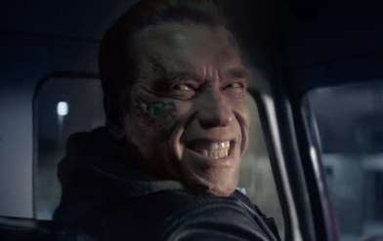
Thank you for your attention!
Student: Goloven Anton
Group: 580961
Minsk 2016

